Slide 1

PREFABRICATED STRUCTURES
UNIT I
INTRODUCTION

Slide 2
DEFINITION
Prefabrication is the practice of assembling components of a structure in a factory or other manufacturing site, and transporting complete assemblies or sub-assemblies to the construction site where the structure is to be located.
It is combination of good design with modern high performance components and quality controlled manufacturing procedures.
This work is carried out in two stages, manufacturing of components in a place other than final location and their erection in position.

Slide 3
"Prefabricated building is a type of building that consists of several factory-built components or units that are assembled on-site to complete the unit. “Prefabricated” are built in:
  Components (panels)
  Modules (modular homes)
  Transportable sections (manufactured homes)
  Mobile homes (houses on wheels)

Slide 4
NEED FOR PREFABRICATION
Speed
Quality
Safety
Sustainability
Cost
Time for change

Slide 5
ADVANTAGES
Saving in cost, material, time & manpower.
Shuttering and scaffolding is not necessary.
Installation of building services and finishes can be done immediately.
Independent of weather condition.
Components produced at close supervision in a controlled environment in factories .so quality is good

Slide 6
Clean and dry work at site.
Possibility of alterations and reuse
Correct shape and dimensions and sharp edges are maintained.
Very thin sections can be entirely precast with precision.

Slide 7
DISADVANTAGES
Handling and transportation may cause breakages of members during the transit and extra provision is to be made.
Difficulty in connecting precast units so as to produce same effect as monolithic. This leads to non-monolithic construction.
They are to be exactly placed in position, otherwise the loads coming on them are likely to get changed and the member may be affected.

Slide 8
High transport cost
Need of erection equipment
Skilled labour and supervision is required.

Slide 9
PRINCIPLES OF PREFABRICATION
The prefabrication will be done in two stages.
1)Manufacturing at factory condition.
2)Erection of components at required location.
This requires certain stage of preparation. They are
i)Casting
ii)Curing
iii)Transportation and erection.

Slide 10
Contd..
Casting: - Precast components are casted with controlled cement concrete in moulds of required shape and sizes. The vibrator is used to vibrate concrete and this removes any honeycombing inside the components.
Curing: - After 24 hours of casting, the casted components are released from the mould and transported to curing tanks. Certain special components like railway sleepers where high strength is required are steam cured.

Slide 11
Transportation and erection: - After complete curing is done the components are transported to the site with heavy trucks and erection will be done using cranes with skilled labor force.

Slide 12
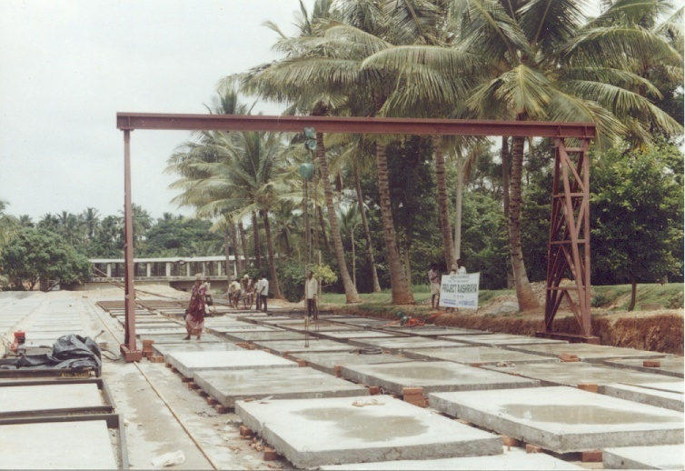
Casting

Slide 13
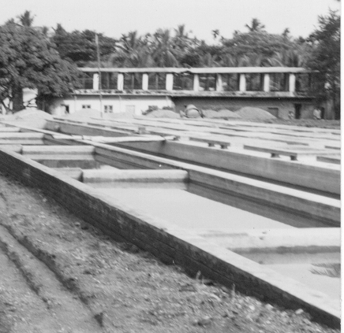
Curing

Slide 14
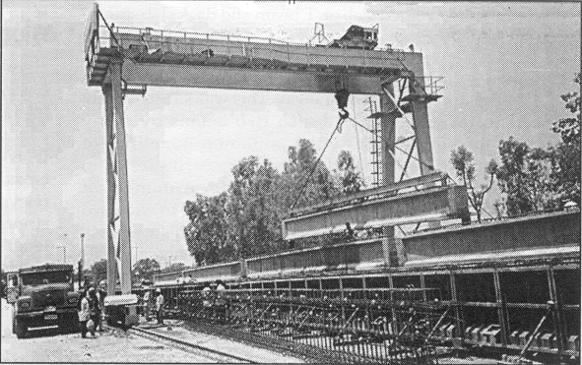
Transportation and Erection

Slide 15
MATERIALS
Structural Insulated Panels (SIPs)
Insulating Concrete Forms (ICFs)
Prefab foundation system
Steel framing
Concrete framing
Large modular system

Slide 16
Structural Insulated Panels (SIPs)
Structural insulated panels (SIPs) are a high performance building system for residential and light commercial construction.
The panels consist of an insulating foam core sandwiched between two structural facings, typically oriented strand board (OSB).
SIPs are manufactured under factory controlled conditions and can be fabricated to fit nearly any building design.
The result is a building system that is extremely strong, energy efficient and cost effective. Building with SIPs will save you time, money and labor.

Slide 17
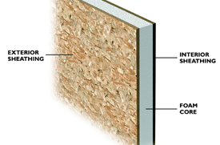

Slide 18
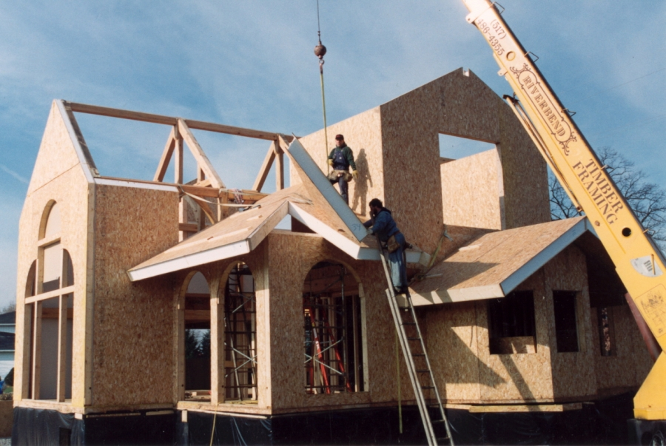

Slide 19
Insulating Concrete Forms (ICFs)
Insulating concrete forms (ICE) are a prefab construction material consisting of hollow EPS (Extended Polystyrene) foam blocks that are stacked and glued together on-site , creating the form that is filled with reinforcing bars and concrete.

Slide 20
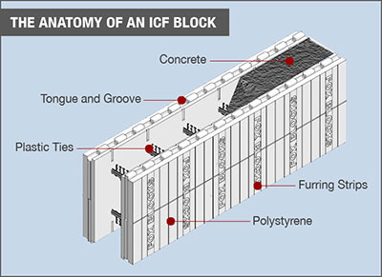

Slide 21
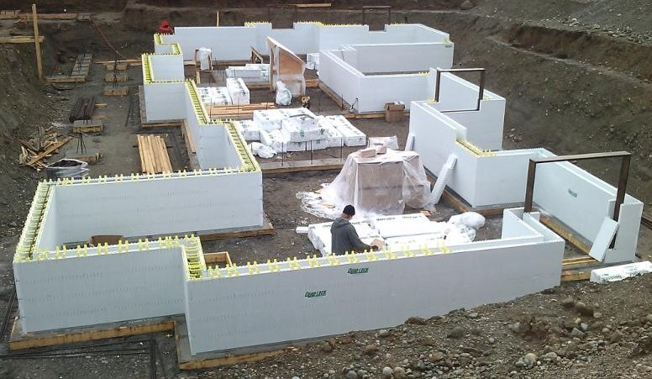

Slide 22
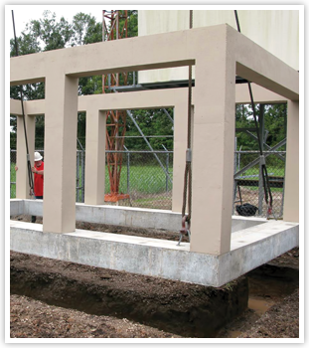
Prefab Foundation

Slide 23
Steel Frames
Prefabricating all of the structural steel and metal components of the building in the factory eliminates the materials waste common in traditional construction, saving materials cost and also being more environmentally friendly. (Any excess materials waste at the factory is 100% recyclable steel.)

Slide 24
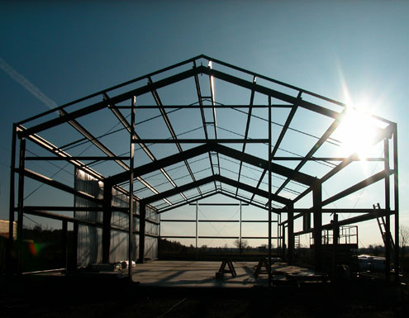

Slide 25
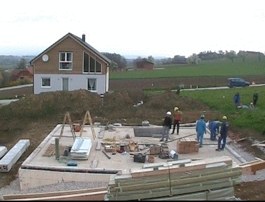

Slide 26
MODULAR COORDINATION
Modular coordination is a concept of coordination of dimension and space, in which buildings and components are dimensioned and positioned in a term of a basic unit or module, known as ‘1M’ which is equivalent to 100 mm.
It is internationally accepted by the International Organization for Standardization (ISO) and many other countries.
The principle objective of modular coordination is to improve productivity in the building industry through industrialization.

Slide 27
Establishment of Modular Coordination
In 1936, Albert Farnell Bernis proposed a module for mass-produced building with size of 4 inches during world war II.
In 1953, “ European Productivity Agency – E.P.A. ” launch a systematic study of modular coordination and the general agreement reached in 1955 with the Munich Convention, called for the adoption of a module with base M = 10cm, as common denomination for correlating the dimensions of all elements involved in architecture and building.
In 1972, Malaysia adopted metric system of measure and only in April 1986, modular co-ordination was introduced in building industry in Malaysia.

Slide 28
Advantages
Modular coordination make single component in to larger combinations
Cutting wastages are minimum in the components.
Base for standardization of mass production of components.

Slide 29
BASIC MODULE
The fundamental module used in modular coordination, the size of which is selected for general application to building and its components.
It is denoted by ‘M’.
The value of basic module ‘M’ has been chosen as 100mm for maximum flexibility and convenience.

Slide 30
The different modules are
i)Basic Module: M
ii)Multi modules: 3M, 6M etc.,
iii)Sub-module: M/2,M/4.etc.,
In prefabricated industry a larger modular unit is called as a project module(M_{p})

Slide 31
OBJECTIVES OF MODULAR COORDINATION
a)Major Objective:
The principal objective of modular coordination is to assist the building design, construction professionals in building industry by standardization in such a way that building components fit with each other, with other components and with building assembly on site, thereby improving the economics of building.
b)Specific Objectives:
Modular coordination
Facilitates cooperation between building designers, manufacturers, distributors, contractors and authorities.

Slide 32
Enables building to be dimensionally coordinated so that they can be erected with standard components without undue restriction on freedom design.
Permits a flexible type of standardization which encourages the use of number of standardized building components for the construction of different types of building.
Optimizes the number of standard sizes of building components.
Encourages as far as possible the interchangeability of components , whatever the material form or method of manufacture.

Slide 33
MODULAR AXIS
In the design of buildings, the modules are made as a grid which consists of parallel lines spaced at the value of module, M or project module (Mp).
A grid line taken as the base for setting out the given part of the building is called as modular axis.

Slide 34
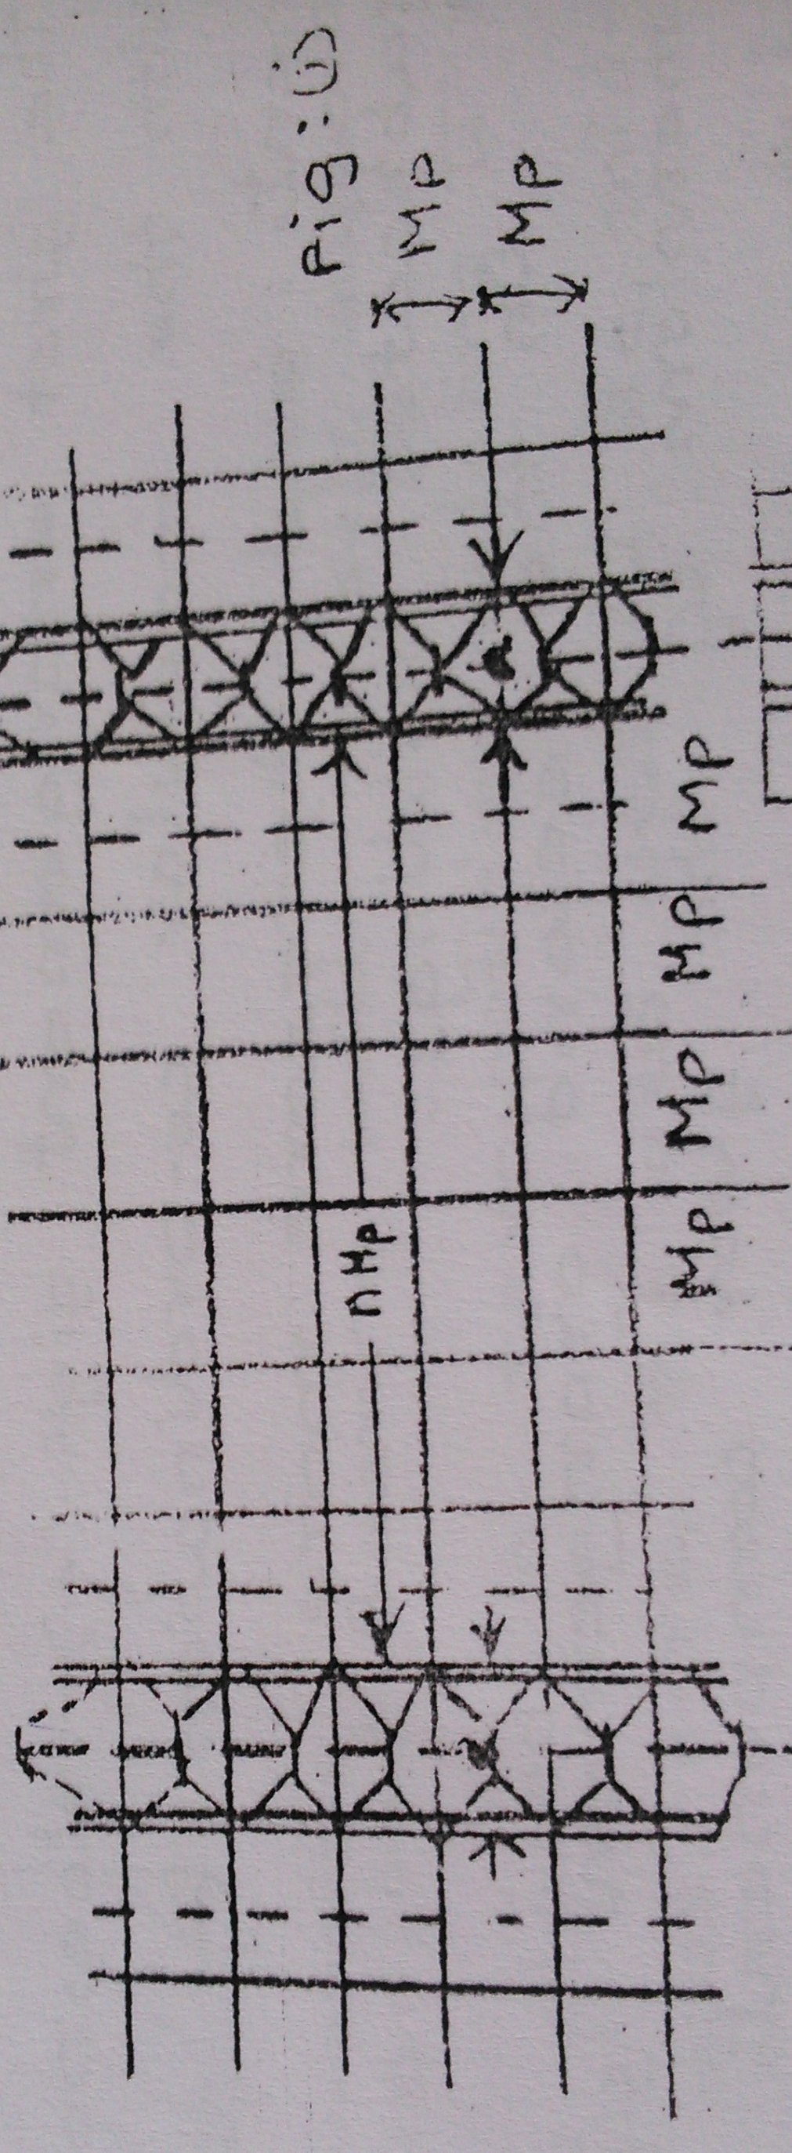

Slide 35
In prefabricated industry the practice is as follows
i)The horizontal co-ordination based on the project module (M_{p})=30cm.
(Note: Larger module unit is called project module)
ii)Vertical coordination based on basic module, M = 10cm.
iii)Floor height in multi storeyed building is fixed as 2.8m. But for buildings having floor less than 15 cm, it may be reduced to 2.7m.
iv)The c/c distance ‘L’ b/w the load bearing walls are selected from the following i.e.,
nM_{p}=2.7,3,3.3,3.6,3.9,4.5,5.1,5.4,5.7,6 m

Slide 36
v)The width of staircase measured b/w centre line of walls is fixed as 2.7m.
vi)In large multiple projects, the dimensions are used which are the multiples of the project module, Mp=30cm

Slide 37
Dimensioning of Prefabricates
The three basic types of unit dimensions are
i)Design or Erection dimension(l_{m})
ii)Theoretical dimension(l)
iii)Actual dimension(l_{w})

Slide 38
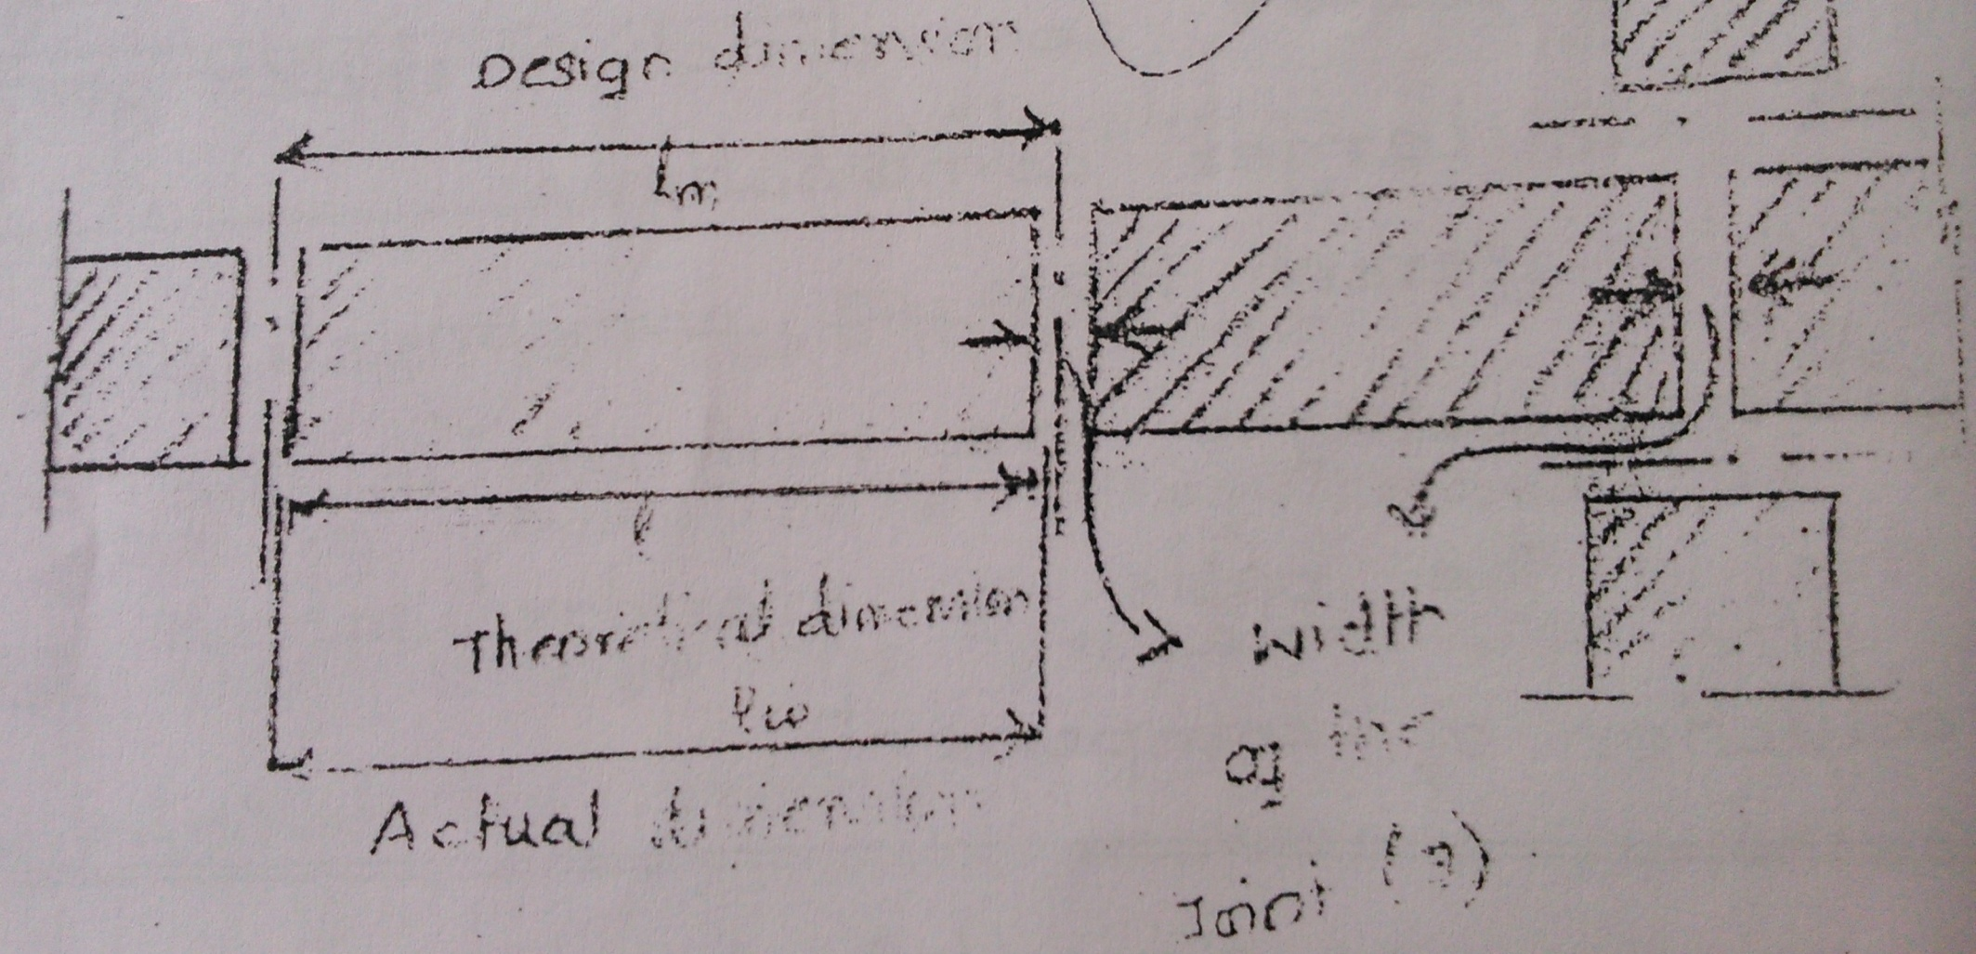

Slide 39
The production discrepancy is defined as difference between the theoretical dimension(l) and actual dimension (l_{w}).
If l<l_{w,} the production discrepancy is positive.
If l>l_{w,} the production discrepancy is negative.
In drawings (working drawings), the theoretical dimensions of the units and the joints b/w them are mentioned.

Slide 40
Coordination of Prefabricates
i)Three dimensional coordination
Prefabricates are connected to its neighbors in 3 directions (l,b,h).
Eg: Wall panel
ii)Superficial coordination
Unit is joined to other unit in 2 direction only
Eg: l, b of a roof panel
iii)Linear coordination
Unit is connected in one direction only.
Eg: length of beam

Slide 41
Diversity of Prefabricates
Large prefabricated units have 3 degrees of diversity
i)I Degree of diversity
Differ from each other in basic shape, cross section of material and their production demand which seperate form work and technology
Eg: wall & floor panel.
ii)II Degree of diversity
Different length or width but can be cast by same methods and using same form work.
Eg:16 module wall panel and 18 module floor panel

Slide 42
iii)III degree of diversity
Difference between the units lies only in the internal details but size or production unit is not effected.
Those are window openings, service holes, surface treatment etc.,
I degree and II degree of diversity affect the capital expenditure.
III degree of diversity affects the basic size, production method and erection.
Normally larger units are made in industry.
If units are large then less work will be on the site and number of joints will also be less.

Slide 43
STANDARDIZATION
It is defined as the process of adoption of generally accepted uniform procedures, dimensions, materials or parts that directly affect the design prefabricated product or a facility.
Advantages of standardization:
Easier in design as it eliminates unnecessary choices.
Easier in manufacture as there is limited variants.
Makes use of specialized equipments easier and quicker for erection and completion.
Factors influencing standardization
To select the most rational type of member for each element from point of production, assembly, serviceability and economy.

Slide 44
To limit the number of types of elements and to use them in large quantities.
To use the largest size to extent as possible , thus resulting in less number of joints.
To limit the size and number of prefabricate by weight in overall dimension so that it can be handled well by handling and erection equipment and can be transported easily.
To have all prefabricates approximately of same weight very near to the lifting capacity of the equipment.

Slide 45
SYSTEM FOR PREFABRICATES
It is a method of construction of buildings by using prefabricated components which are inter-related in functions.
The degree of flexibility varies from system to system.
However in all the system, there is a certain order and discipline.
The various prefabrication system are
i)Open prefab system
ii)Large panel prefab system
iii)Frame systems
iv)Lift slab systems
v)Box type system

Slide 46
i)Open Prefab System
This system is based on the use of basic structural elements to form whole or part of building. The standard prefab concrete components which can be used are prefabricated slabs, prefabricated beams, columns, precast lintels and sunshades etc.,
Foundation for the columns could be prefabricated or conventional cast in-situ depending upon the soil condition and load.
The columns may have hinged or fixed base connections depending upon the type of components used and method of design adopted

Slide 47
Two types of open prefab system are
  a)Partial prefab open system
  b)Full prefab open system
  a)Partial prefab open system
  This system emphasizes the use of prefabricated roofing and flooring and other minor elements like lintels, sunshades, kitchen sills in conventional building construction.
  b)Full prefab open system
  All structural components are prefabricated

Slide 48
ii)Large panel prefab system
Based on use of large panel prefab system.
Components used are prefabricated large panels for walls, floors, roofs, staircases etc.,
It is a box like structure.
Both horizontal and vertical members are load bearing.
The prefabricated large panel walls can be classified as
a)Cross wall system
b)Longitudinal system

Slide 49
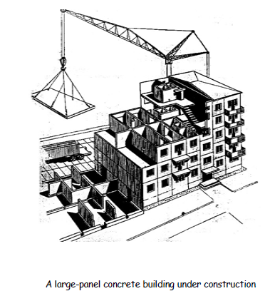

Slide 50
a)Cross wall system
Cross walls are load bearing and facade walls are non load bearing.
Suitable for high rise buildings
b)Longitudinal wall system
Cross wall is non load bearing and longitudinal walls are load bearing.
Suitable for low rise buildings.
Prefabricated floors
Depending upon the composition prefabricated floors are classified as
a)Homogeneous floor
b)Non homogeneous floor

Slide 51
- Depending upon the way loads are transferred, the prefabricated floors are classified as
a)One way system
b)Two way system
iii)Frame System
Components are usually linear elements.
The beams are seated on the corbels of pillars usually with hinged joints. (rigid connection is also carried out).
Joints are filled with concrete at site.

Slide 52
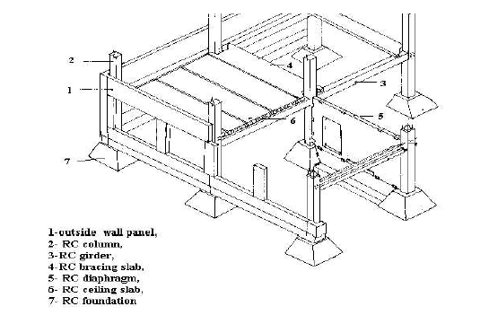

Slide 53
iv)Lift Slab System
Partially prefabricated in plant (pillars) and partially precasted on site (slabs).
It consists of one or more high pillars (max 5).
Up to 30 storey high construction is possible.
Consists of specially designed joints and temporary joints.
Slabs are casted on the ground (one on top of another) and then lifted with cranes and elevators.

Slide 54
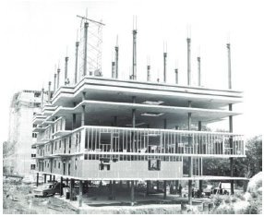

Slide 55
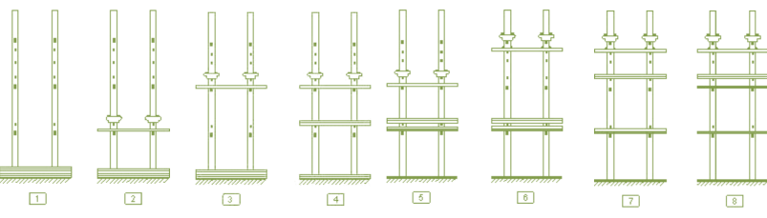

Slide 56
Lift-Slab Procedure:
i)Pillars and first package of slabs (Eg: 5 pieces) are prepared at the ground level.
ii)Lifting boxes are mounted on the pillars and a single slab is lifted to first floor level.
iii)Other boxes are sequentially raised to higher position to enable the slabs to be lifted to their required final position. Slabs are held in relative position (temporary) by pinning system.

Slide 57
v)Box Type System
In this system room size units are prefabricated and erected at site.
Toilet and Kitchen blocks could also be similarly prefabricated and erected at site.
This system derives its stability and stiffness from the box units which are formed by four adjacent walls which are joined to make rigid connection.

Slide 58
PRODUCTION OF PREFABRICATES
Stand System
Conveyor belt or production line system
Aggregate system

Slide 59
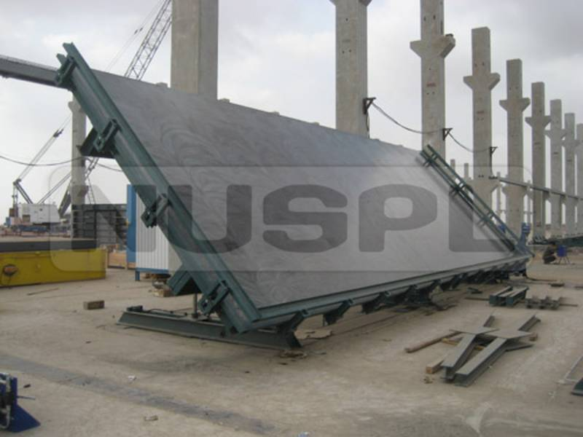
Tilting Table

Slide 60
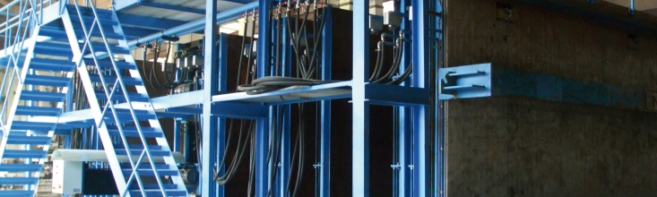
Battery Mould

Slide 61
TRANSPORTATION
Transportation means taking the prefabricates in a vehicle of wagon or truck from the prefabrication industry to the place of site work for erection.
In addition to railway wagons, special transporters are used to carry the prefabricated units from the factory to the building site.
These are designed to suit the prefabricate dimensions and weight and convenient method of loading.
In some places, the lorries are used to transport large prefabricates which are equipped or having power operated unloading derricks.(cranes or lifting mechanism)

Slide 62
The following points should be considered for transporting the prefabricates
It must be carried out with extreme care to avoid any jerk and distress in elements and handled /transported in the same orientation as it is to be placed in final position.
It should be properly planned and conformity with traffic rules and regulation.
The size of element decide the mode and size of transport vehicle.
Check the load carrying capacity of the bridges.

Slide 63
vi) Avoid excessive cantilever projection while transport.
vii) Special care should be taken while moving in curves and uneven roads which may lead to undesirable stresses.
viii) Before loading, proper base packing materials, proper location and packing must be done one over the other.
Delivery:
Delivery of prefabricate elements should be planned according to the general erection sequence to minimize unnecessary site storage and handling.

Slide 64
ii) Prefabricate elements should be loaded and delivered with proper supports and frames. Cushioning and tie-downs to prevent damage during transports.
iii) Adequate packing or protection to the edges of prefabricate elements should also be provided to minimize the risk of damage during transport.
Handling:
i) Lifting and handling position shall be clearly defined particularly if sections are critical.
ii) It mainly involves the removal of prefabricate elements from mould, transportation to the storage yard and unloading operation and erection of these element at the job site.

Slide 65
iii) Prefabricate elements are demoulded and transported to the site only when concrete reach required strength.
iv) But these elements haven’t got full design strength and prone to damage during handling.
v) So it has to be carefully handled to avoid excessive stress during handling.

Slide 66
ERECTION
Erection of building means keeping of prefabricated products in proper and correct position at the site.
Before doing the erection the setting out should be done and carefully checked with survey instruments.
While erection the working of the crane and the correct layout of the crane must be checked.
Uneveness of the ground, makes it difficult to lay a horizontal crane truck.
When there is steep slope, high embankment is required and this is costly and technically difficult.

Slide 67
Prefabricated buildings are erected in convenient sections.
Sections should be correctly fixed and should be rigid in all directions.
The normal sequences of erections are
i)Structural wall units.
ii)Non-structural wall units (partition).
iii)Floor panels, balconies, staircase units.
iv)Specialized pre-fabricates( chimneys, ventilation ducts, sanitary installations).

Slide 68
The materials required for construction are also lifted by crane and stacked on the floor at the place of work.
In large panel buildings, where two external and one internal wall panels meet at common joint, the external panels are erected first and the joint between them is sealed or covered and then the internal wall panel is placed.
ERECTION PREPARATION:
i)Check the crane access to site and erection platform to prevent cranes or trucks damaging the concrete floors during access.

Slide 69
ii)Obtain verification that the erection platform can support the erection loads.
iii) Ensure the locating dowels and levelling shims are correctly located.
iv)Clear the site for truck.
v)Ensure sufficient space is available for precast propping or panel bracing.
vi)Builder must ensure that adequate temporary base restraint is provided for any prefabricate element to prevent sliding failure at the base.
vii)Check lifting inserts are in their correct location and recesses are cleaned in preparation for lifting.

Slide 70
Types of Cranes
1)Stationary Cranes
a)Guyed derrick crane
b)Climbing crane
c)Tower crane with fixed base
2)Cranes on rails
a)Portal crane
b)Tower cranes
3)Mobile crane moving on ground
a)Truck mounted
b)Crawler mounted

Slide 71
a)Guyed derrick crane
Used on framed buildings for erection of floor panel, columns and slab strips.

Slide 72

Guyed Derrick Crane

Slide 73
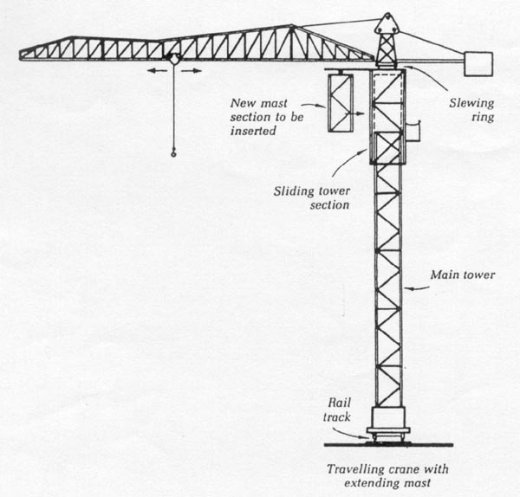
Climbing Crane

Slide 74
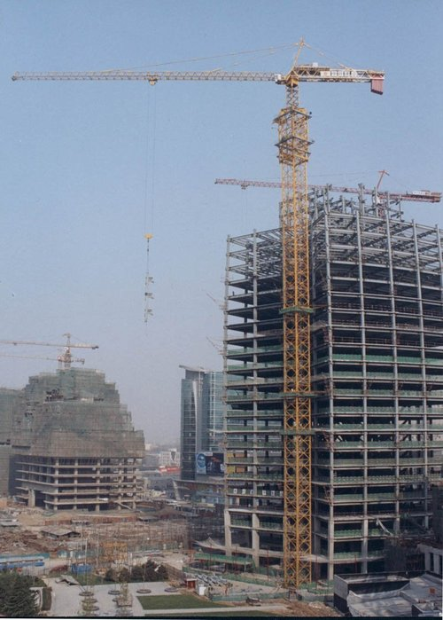
Tower Crane

Slide 75
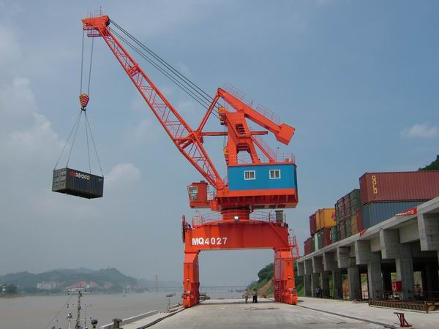
Portal Cranes

Slide 76
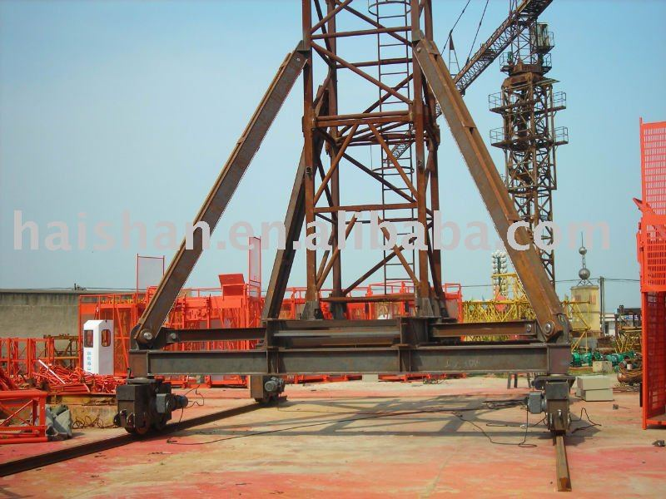
Tower Cranes on rail

Slide 77
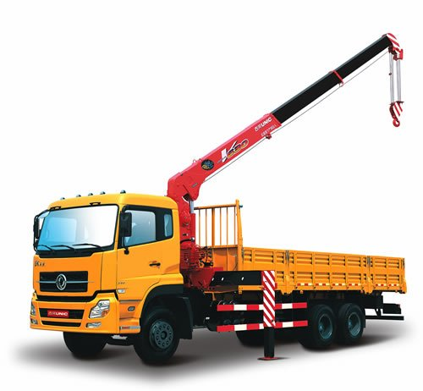
Truck Mounted Crane

Slide 78
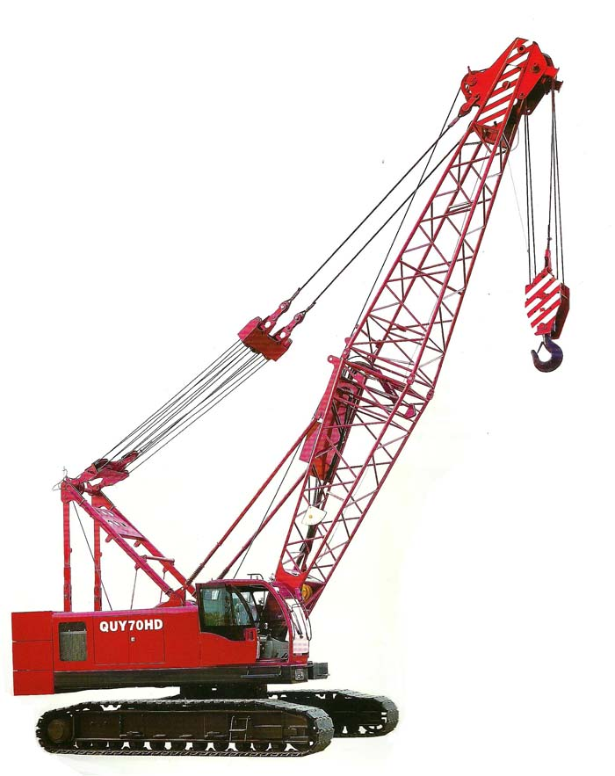
Crawler Mounted Crane

