Slide 1

PREFABRICATED STRUCTURES
UNIT IV
JOINTS IN STRUCTURAL MEMBERS

Slide 2
Connection Requirements
Structural Requirement
Tolerances
Aesthetical Requirements
Mode of erection
Necessity of checking and adjusting
Finishing requirements
Manufacture
Transportation and storage
Costs

Slide 3
Designing the Connection
Design of connection must be based on the relevant standard specification codes of practice, rules by-laws and any other essential requirement.
The following points should be considered
a)Loading under working condition
b)Stability of structure
c)Load conditions during erection
d)Effects of shrinkage, creep and temperature
e)Unequal settlements

Slide 4
Recommendations for detailing
Reinforcement anchorages.
Threaded and non threaded inserts
Chamfers
Bond
Holes for dowel bars
Bolted connections

Slide 5
Structural Connections
Joining of column to footing
Column to beam
Column to column
Beam to beam
Main beam to secondary beam.
Lengthening of columns
Forming of joints of arched structures
Joining of post tensioned structures
Joining of precast to monolithic reinforced concrete structures

Slide 6
Column to column connection
i)Column to column connection by bolts
ii)Column to column dowelled connections
iii)Column to column connection by welding on steel bearing faces
iv)Column to column connection by welding steel flat bars
v)Column to column connection by butt welding of reinforcing bars
vi)Column to column connection by lap welding of reinforcing bars.
vii)Coupling of reinforcing bars
viii)Post tensioning
ix)Hinge connection

Slide 7
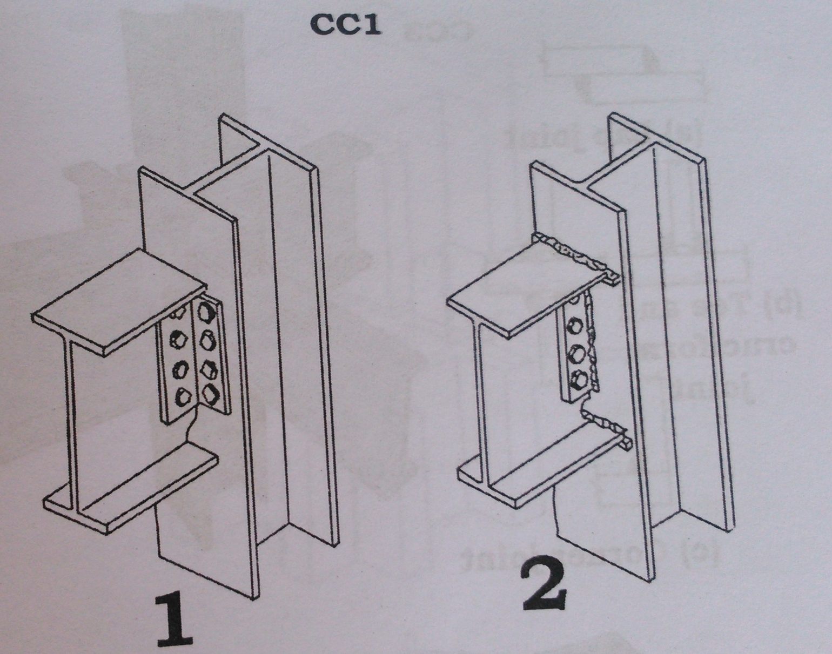
Bolted Connection

Slide 8
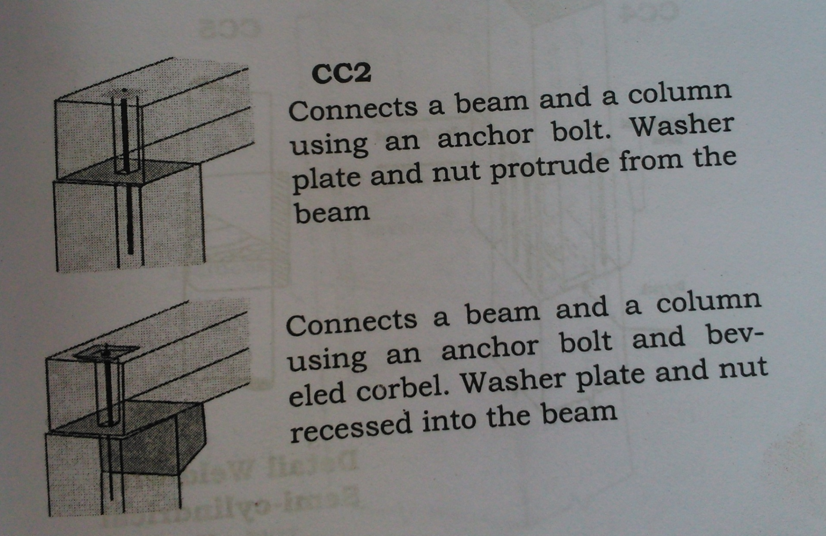
Dowelled Connection

Slide 9
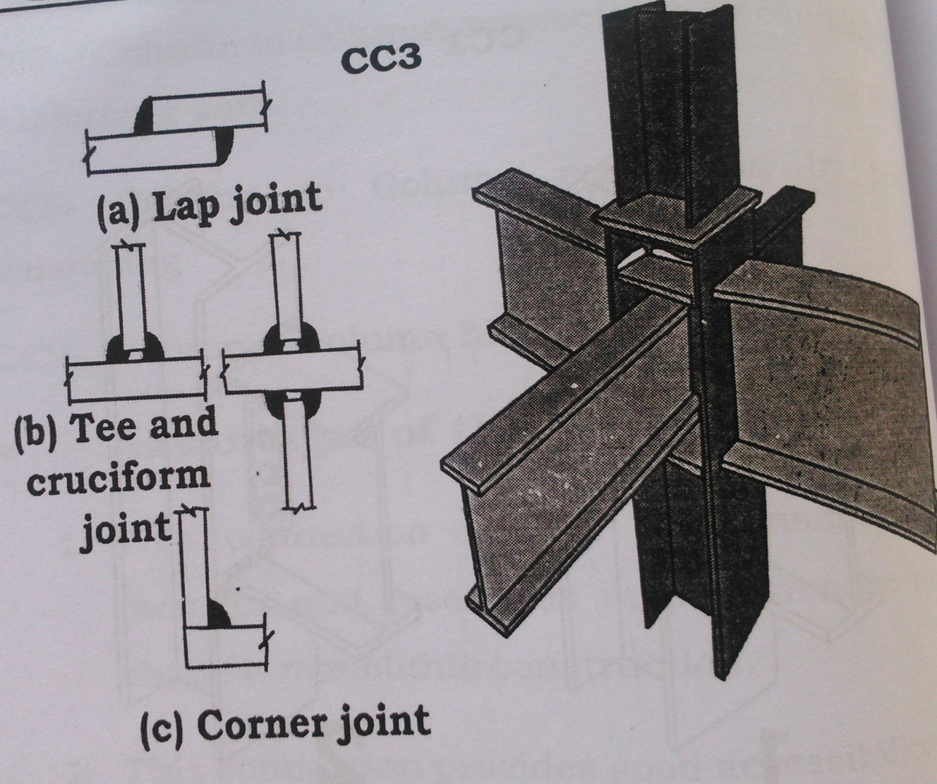
Welding on steel bearing surfaces

Slide 10
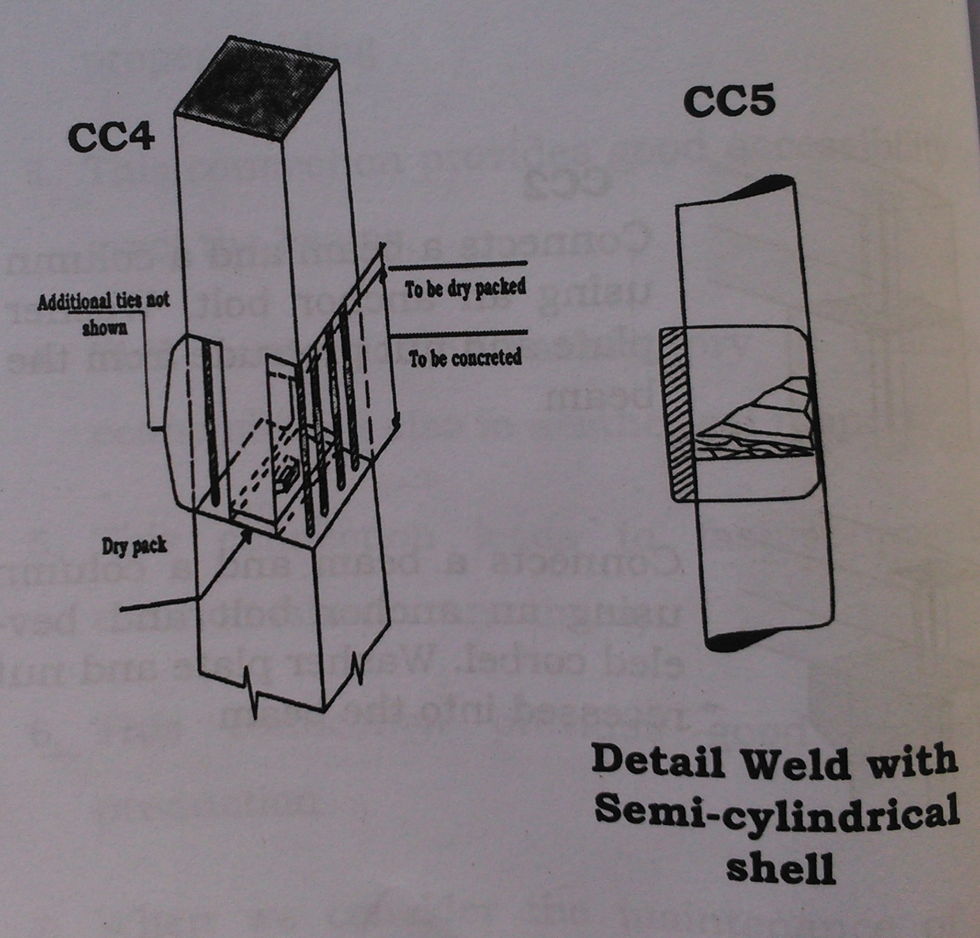
Welding on steel flat bars & butt welding

Slide 11
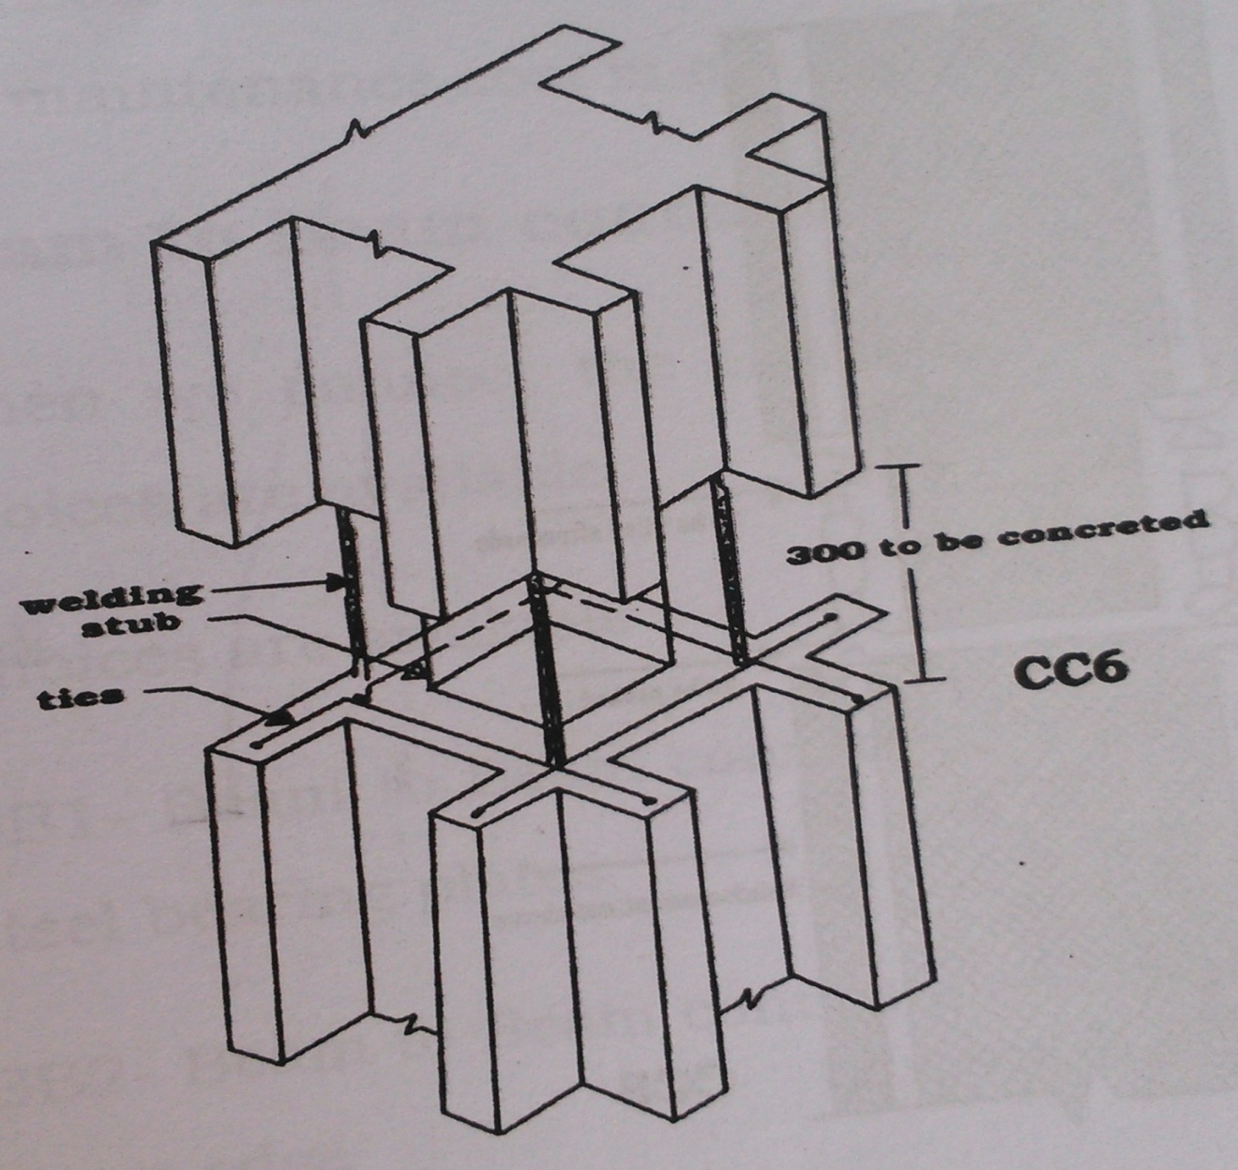
Lap Welding

Slide 12
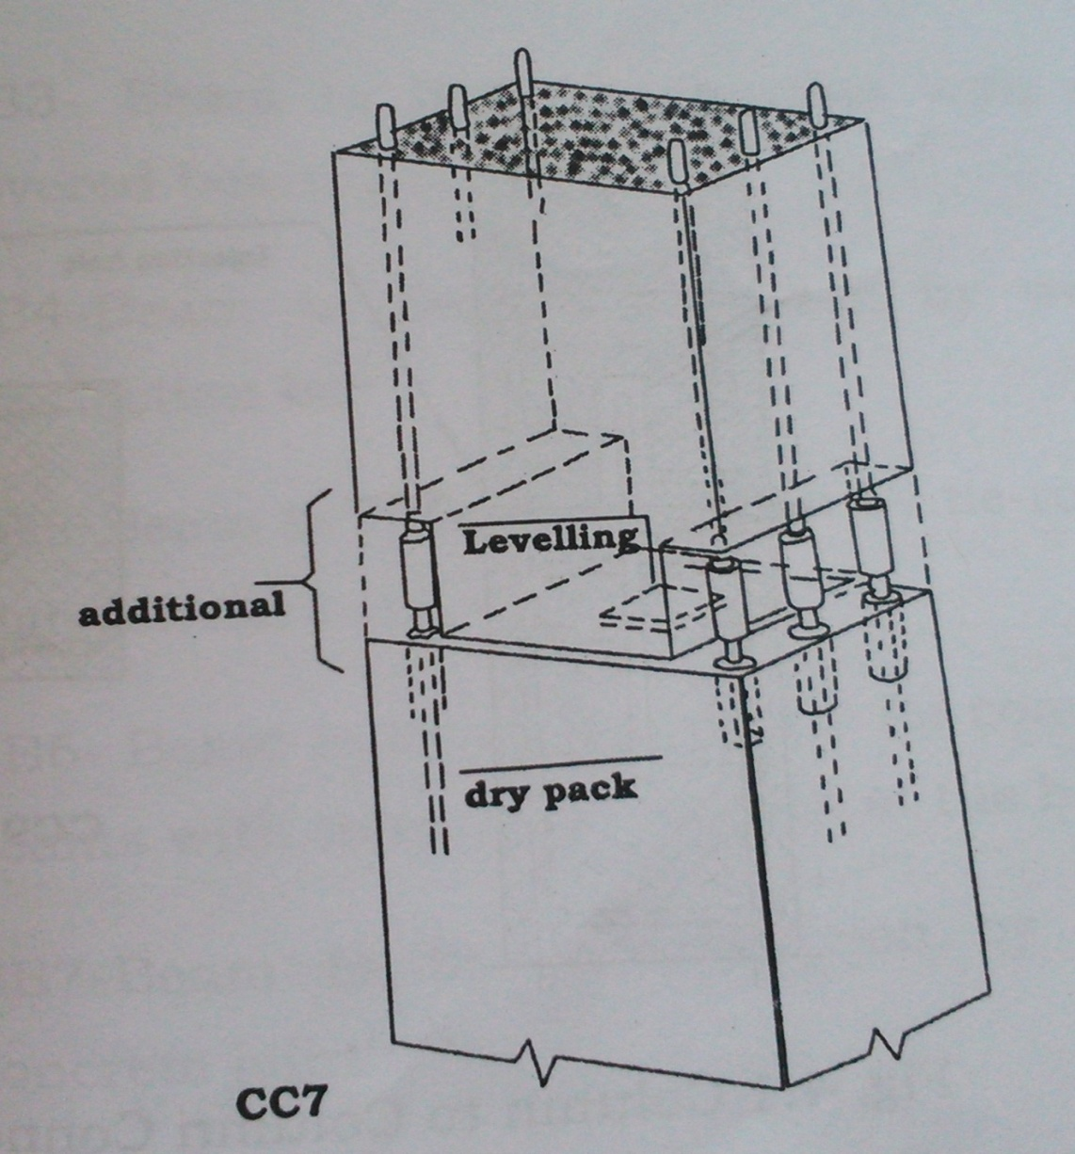
Coupling of Reinforcing bars

Slide 13
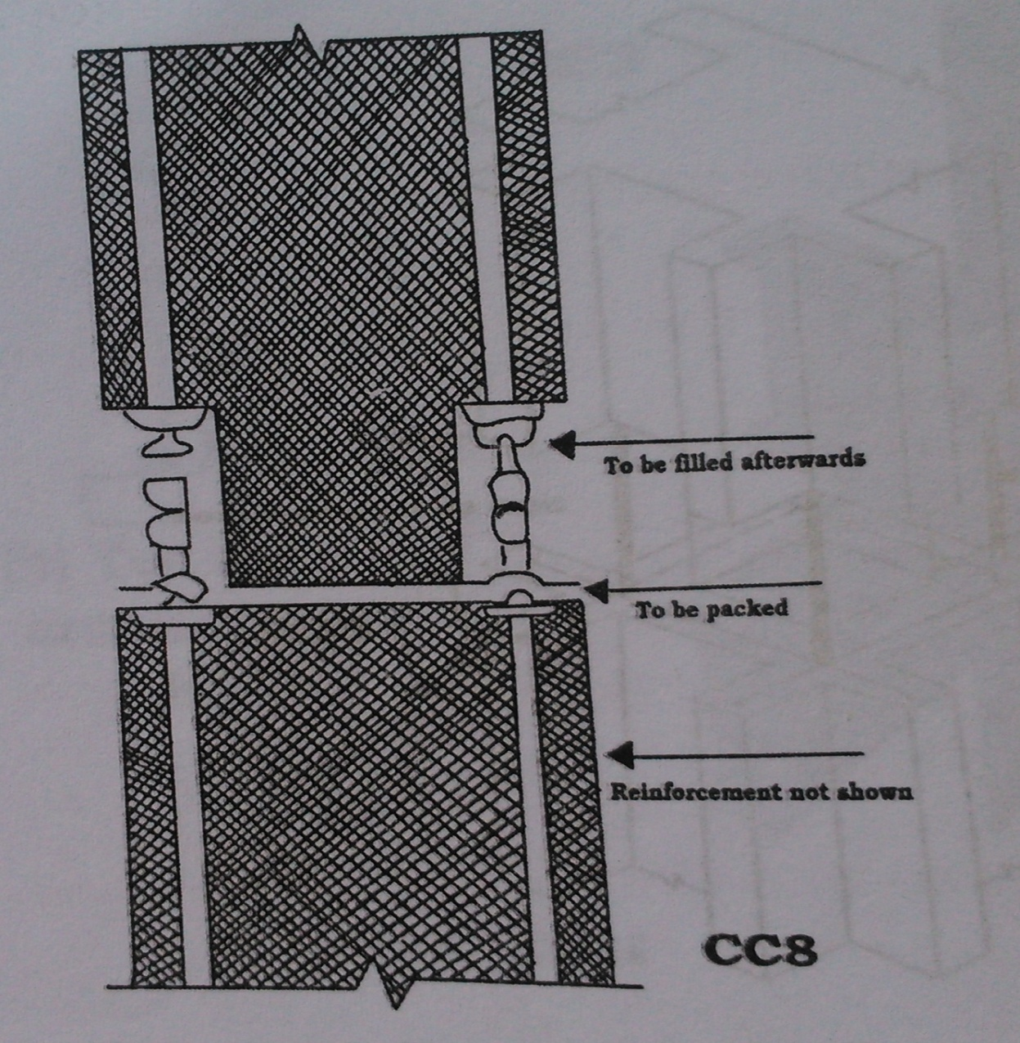
Post Tensioning

Slide 14
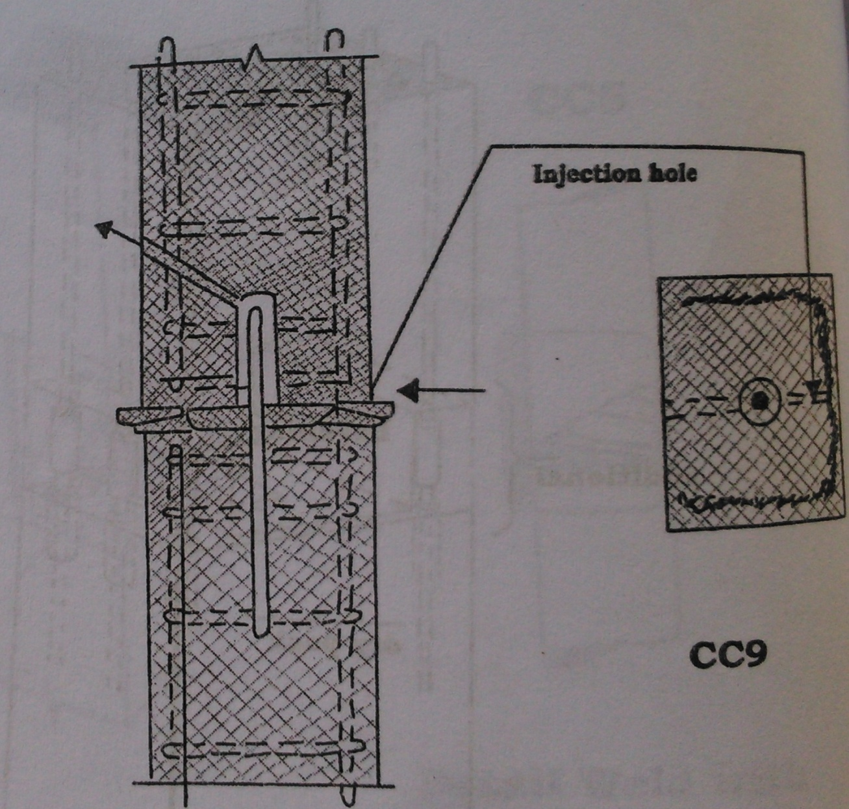
Hinge Connection

Slide 15
Advantages
Transmits large moment and resembles in shape and performance similar to monolithic construction.
Provides good accessibility for proper welding.
Provides good accessibility to erect the beams.
Connection is satisfactory in technical, economical and aesthetic aspects.
Leads to fastest possible erection.
Provides good corrosion protection.
No need of maintenance.

Slide 16
Beam to Beam Connection
i)Beam to Beam connection with vertical steel bearing plates.
ii)Beam to beam connection with notched beam edge
iii)Beam to beam connection with steel covered bearing faces
iv)Beam to beam connection by welded connection bar
v)Beam to beam connection by tie-rods or high tensile bars
vi)Beam to beam connection for composite beams with tension connection at the bottom
vii)Beam to beam connection by in-situ concrete joint
viii)Beam to beam connection by steel plates bolted together

Slide 17
ix)Beam to beam connection by steel plates connected by square pins
x)Beam to beam connection by post tensioning

Slide 18
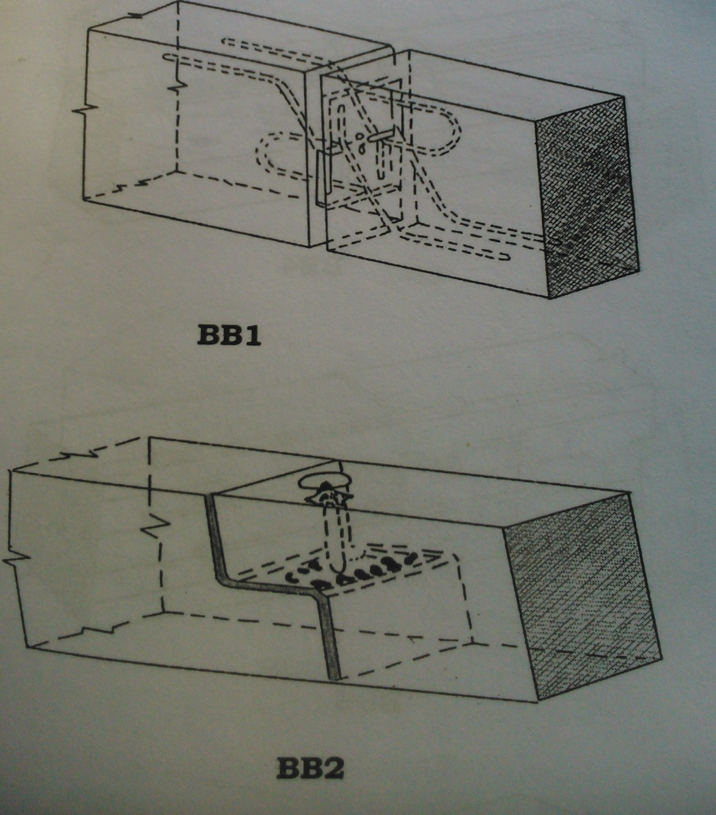
Vertical steel bearing plates and Notched beam edge

Slide 19
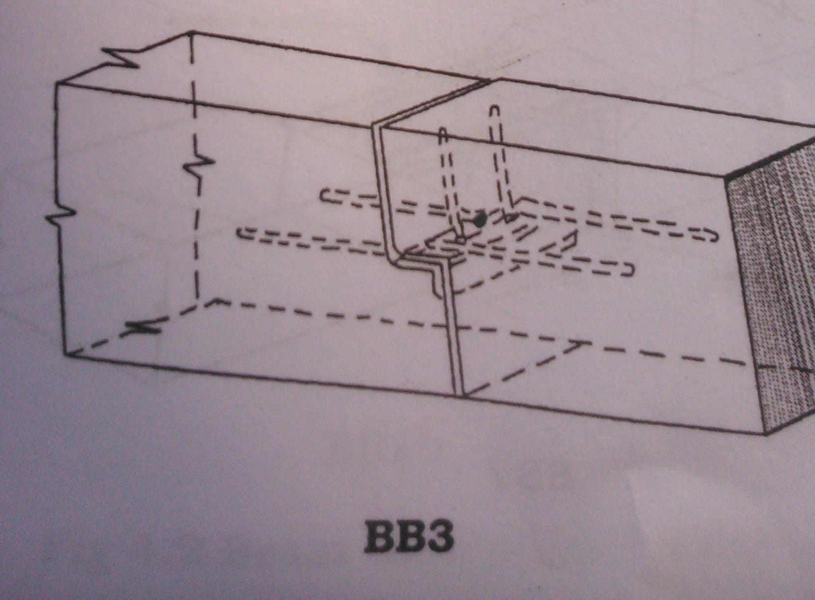
Steel Covered bearing faces

Slide 20
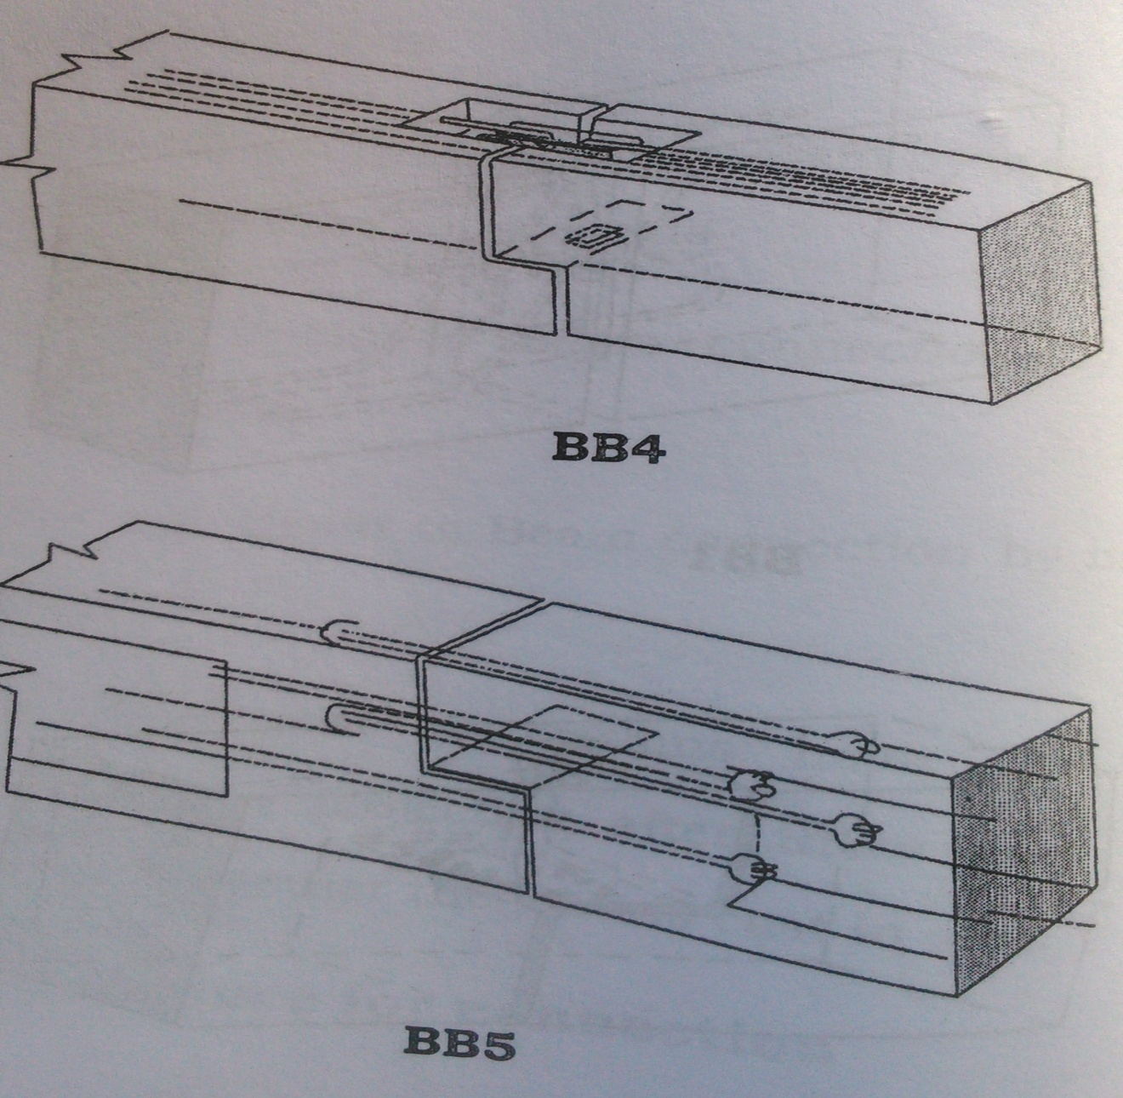
Welded Connection bar and Tie-rods

Slide 21
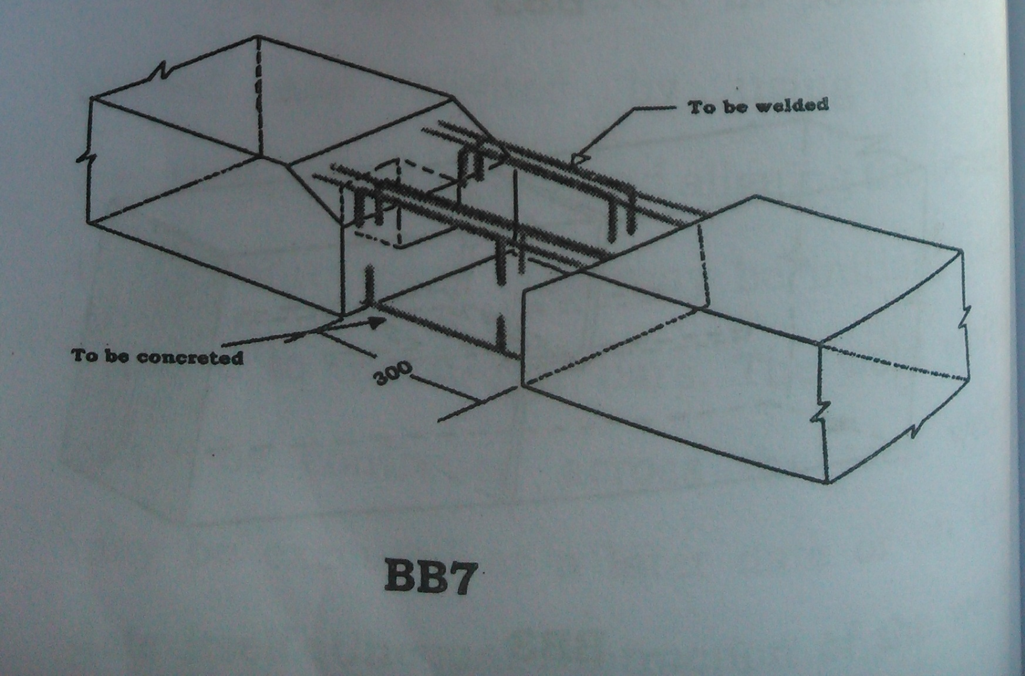
In-situ Concrete joint

Slide 22
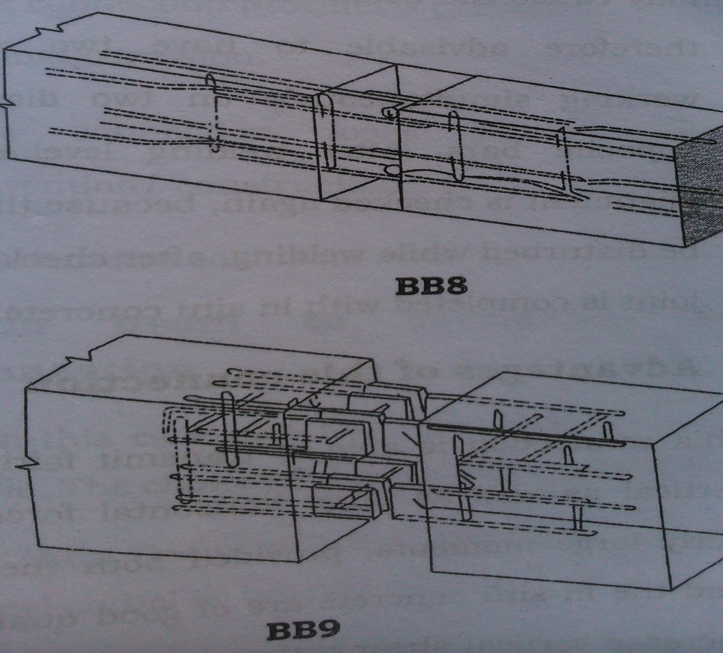
Bolted Steel plates and Connection by square pins

Slide 23
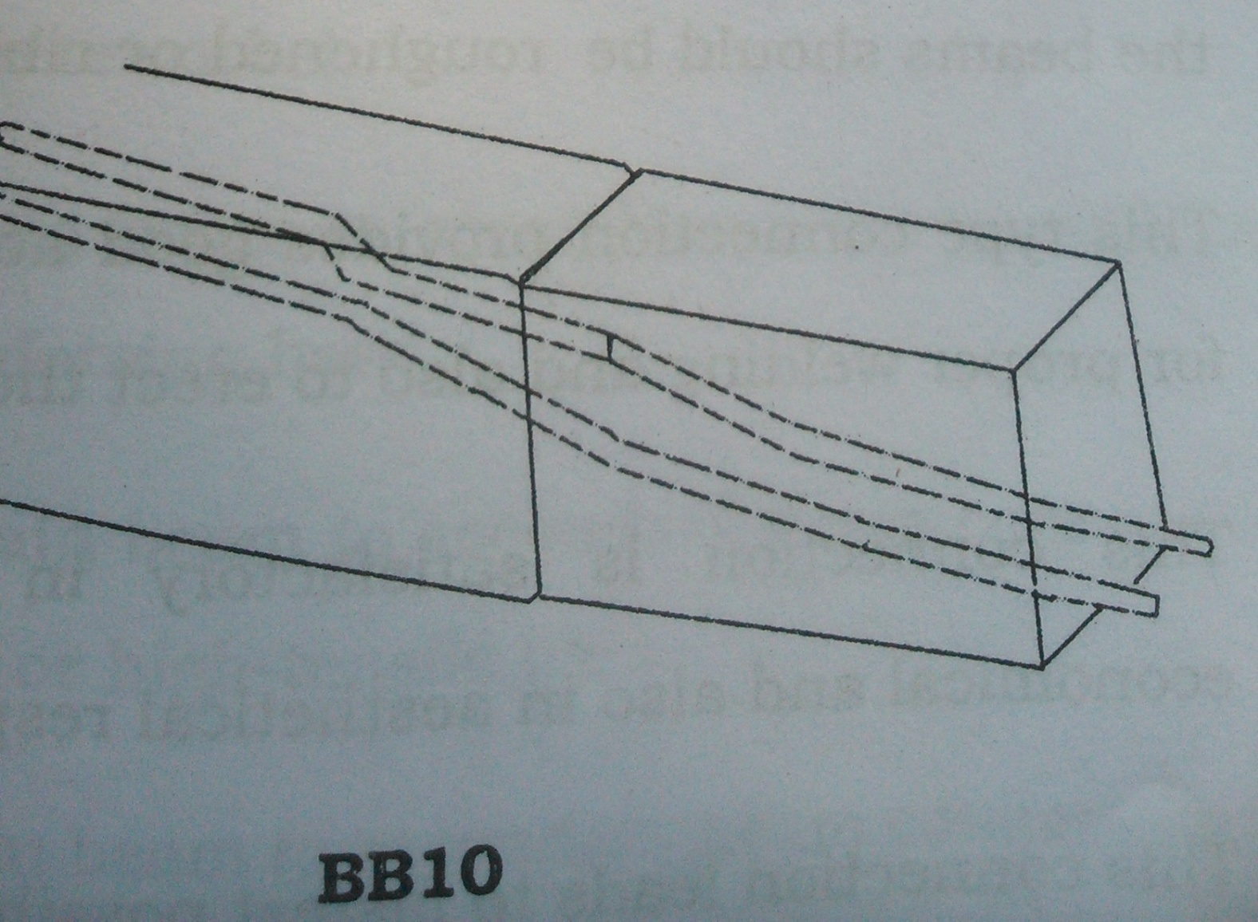
Post tensioning

Slide 24
Procedure:
Beams are erect in position and leveled and aligned using suitable supports.
After leveling and aligning the beams, the reinforcement bars may be initially tack welded to the starter bars.
The weld which must be continued across the tack welds may be executed at a later date or on that date itself.
Unequal contraction of the welds may cause the beam to pull out of true.

Slide 25
It is therefore advisable to have two welders working simultaneously on two diagonally opposite bars.
After welding, leveling and alignment is checked again, because this may be disturbed while welding.
After checking, the joint is completed with in-situ concrete.

Slide 26
Advantages:
Connection is able to transmit large horizontal, vertical forces and moments very well.
Provides good accessibility for proper welding and also to erect the columns.
Connection is satisfactory in technical, economical and in aesthetical aspect.
Connection leads to fastest possible erection.
Connection provides a permanent protection against corrosion.
Connection looks like a ordinary convention/ construction.
Maintenance cost is nil.

Slide 27
COLUMN TO FOOTING
Usually rigid joints.
May also hinge-like sometimes
The different methods of connecting column and footing are
a)Column placed in to a calyx
b)By welding

Slide 28
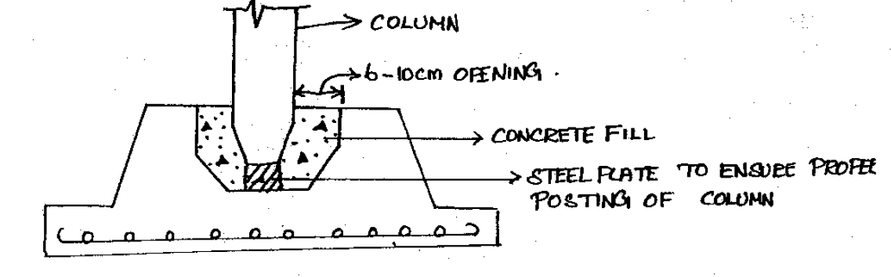
Column placed in a Calyx

Slide 29
A rigid joint is made by placing the column in to a calyx of the footing.
Column is placed in a calyx to a depth of 1.56m.
The depth of calyx should be 12-15% of the length of column.
The opening of the calyx is 6-10cm greater than in all direction than the c/s in column.
This is to make a vibrator to be operated while concreting.
To ensure proper vertical position of the column, a steel plate is placed at the bottom of the calyx and checked by leveling before concreting.

Slide 30
Similar steel plate is placed at lower end of the column.
When positioning the column these steel plates set on each other to take heavy concentrated loads.
Steel plate size may be between 100X100X10mm to 150X150X10mm.
Advantages of calyx joints:
i)The placing, plumbing and fixing of column and the filling of the concrete with calyx is very simple and requires less time than in case of welded joint.
ii)This method is least sensitive to inaccuracies occurring during construction.

Slide 31
Disadvantages:
i)The moment arising from the end fixing of column which requires a double bearing and the column should reach in to calyx and end of the column head and calyx must be dimensional to bear the load.
ii)Use of welded joints is now becoming effective. This joint is accessible and ensures a well executed work and more economical for larger numbers than the calyx joints.

Slide 32
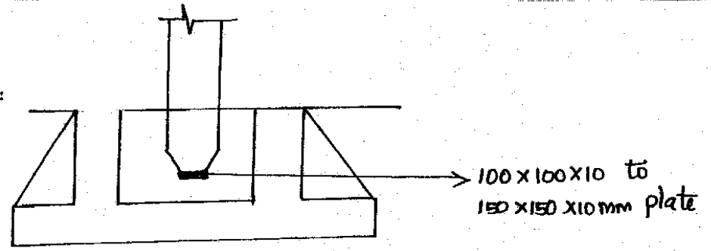
Welded joint of column to footing

Slide 33
The use of welded joint allows the c/s of joint to be enlarged.
A column can also be joined to footing by following three methods
a)Overlapping steel bars
b)Hooked steel bars
c)Welded joints
In all the above methods, column rest on the footing by a tongue like extension for which the c/s is small.
The joints made by these three methods are carefully made and perfectly rigid.

Slide 34
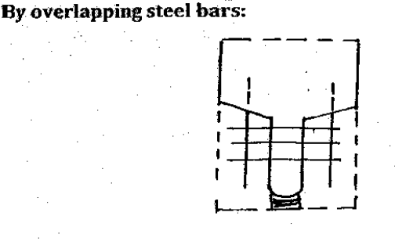

Slide 35
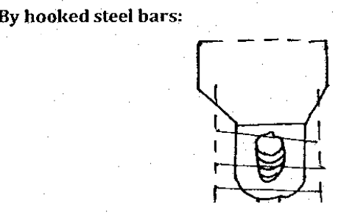

Slide 36
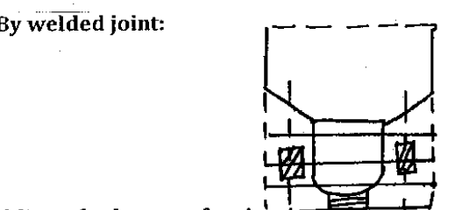

Slide 37
Advantages:
It is effective and widespread method.
It is easily accessible
It ensures well executed work and adequate control.
It is more economical for larger members than calyx method.

Slide 38
Loop formed steel bars:
A column can be fixed to its footing by loop shaped steel bars of main reinforcement projecting beyond the lower end of the column in to properly shaped holes in to the footing.
These holes must be concreted immediately .
For smaller columns, two anchoring holes are needed and for larger columns, four anchoring holes are needed.

Slide 39
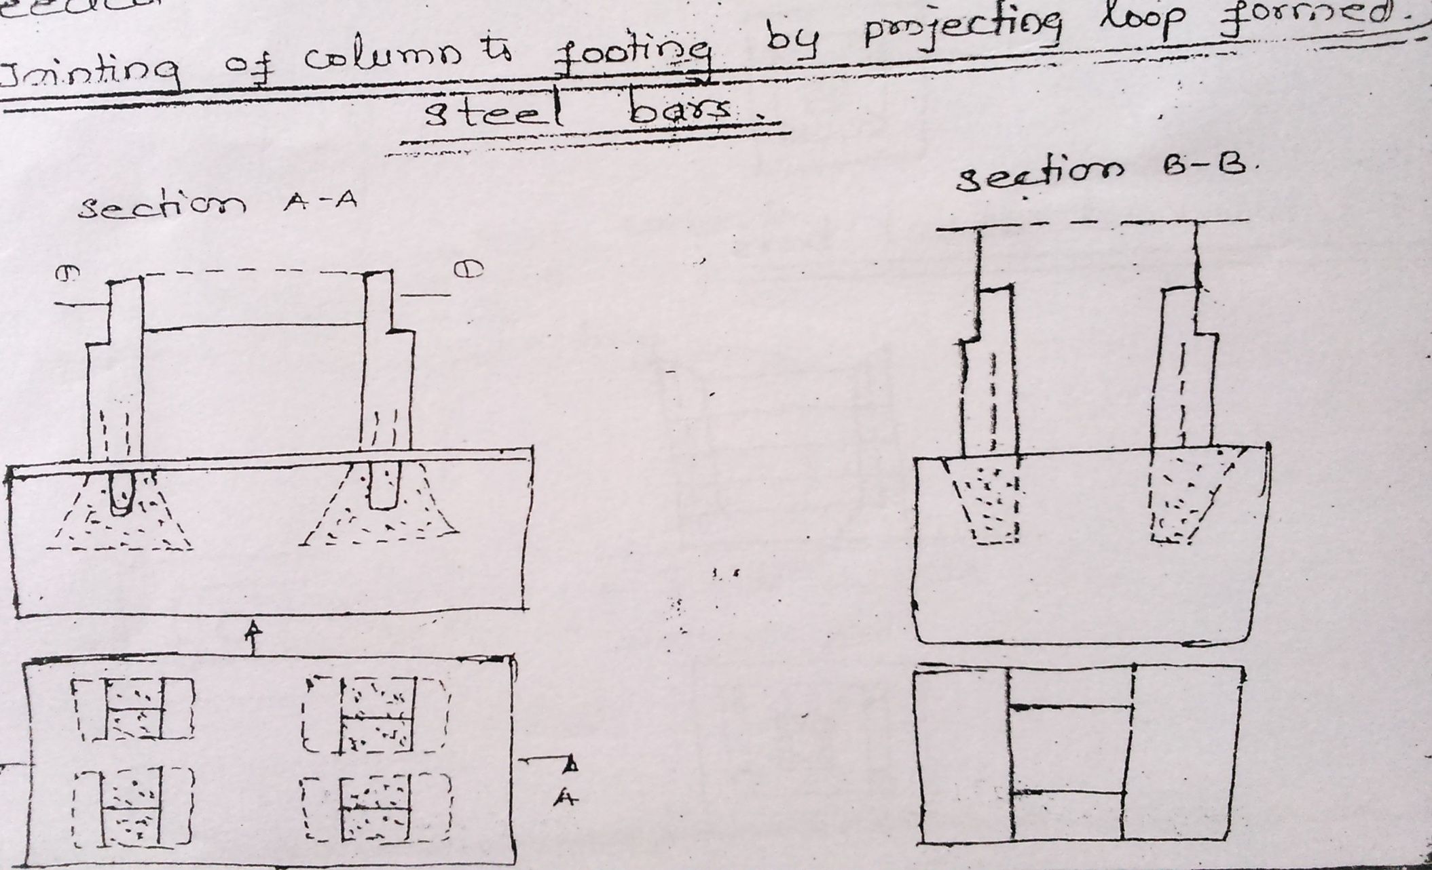

Slide 40
Joining of column to footing by bolts:
Column can be joined to footing with the help of anchor bolts.
A cement mortar layer is put on the upper surface of the footing before placing the column.

Slide 41
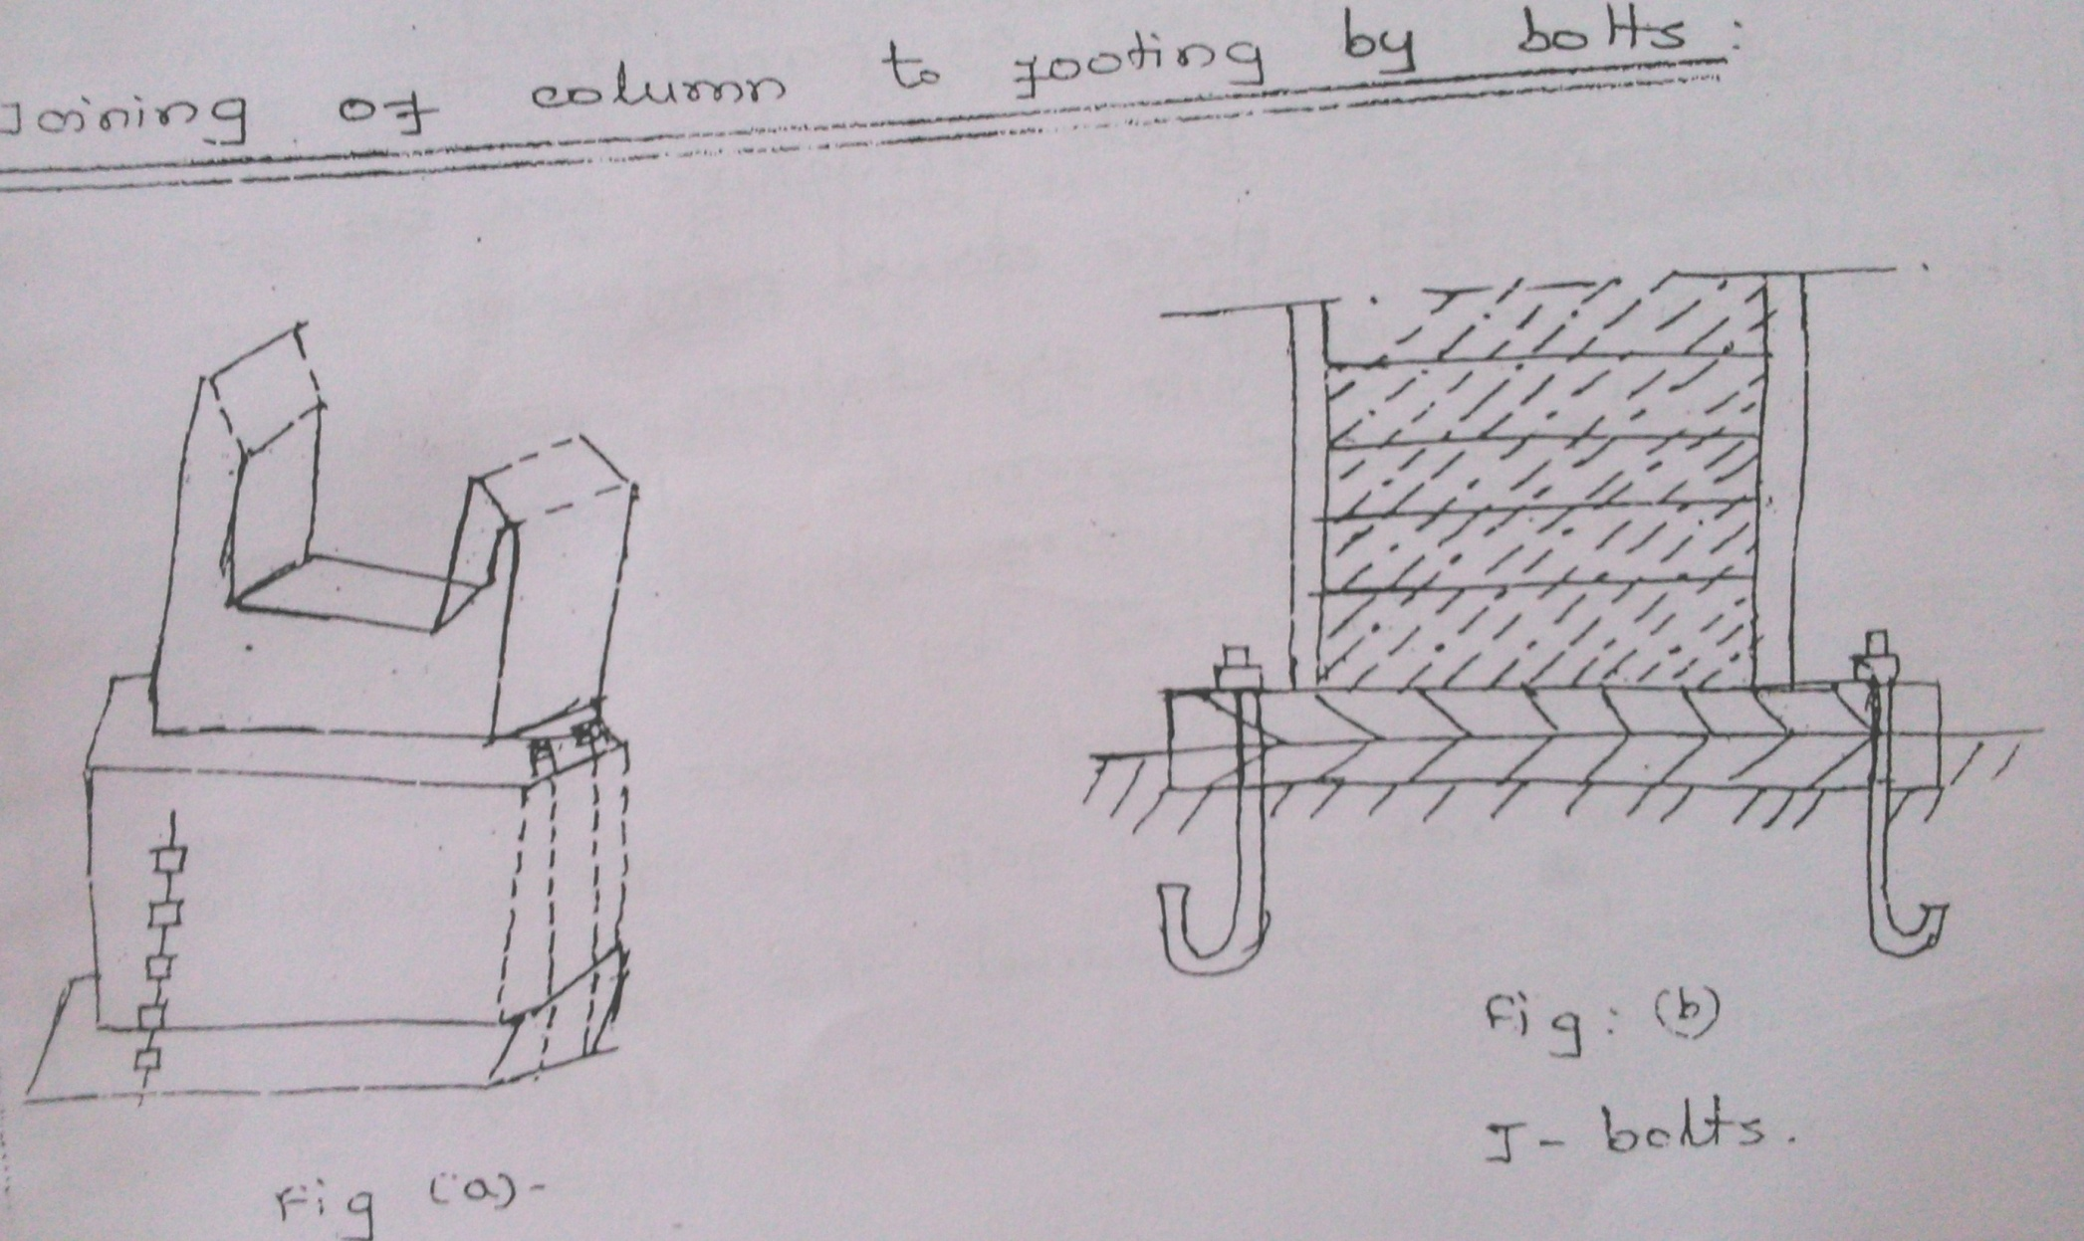

Slide 42
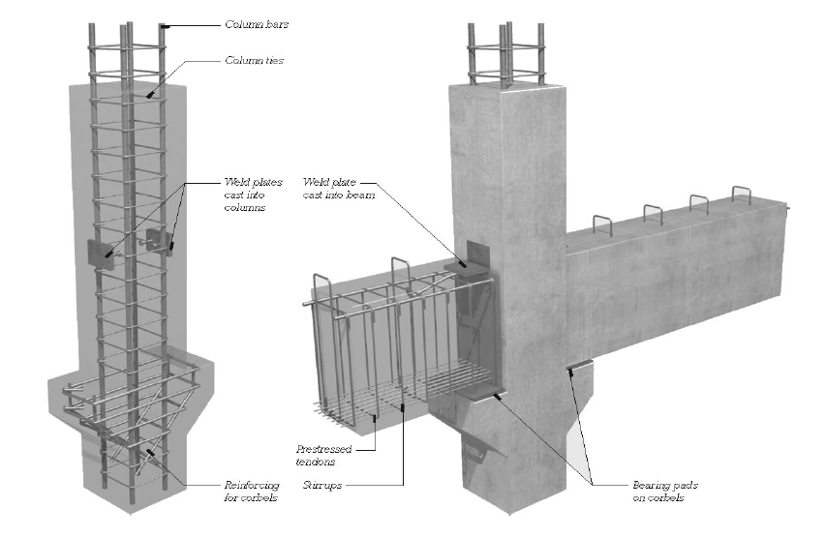
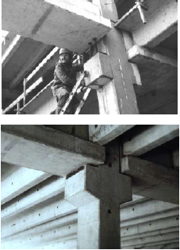
COLUMN TO BEAM CONNECTION

Slide 43
a)Joining of beam and column on top of column:
The simplest method for a rigid junction between column and a girder.
It can be done in two ways
a)By overlapping steel bars
b)By welding

Slide 44
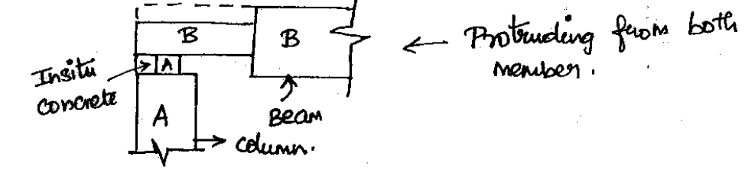

Slide 45
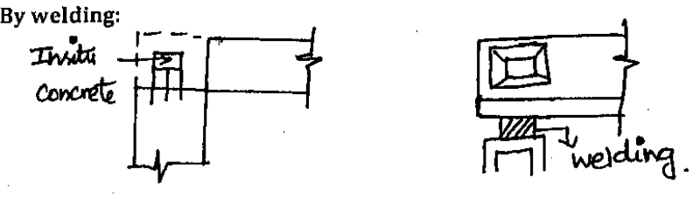

Slide 46
Limitations:
Demands more care and skill.
Increased use of steel
Execution of work is complicated because the work must be performed at greatest height on a light scaffold suspended on the beam itself.

Slide 47
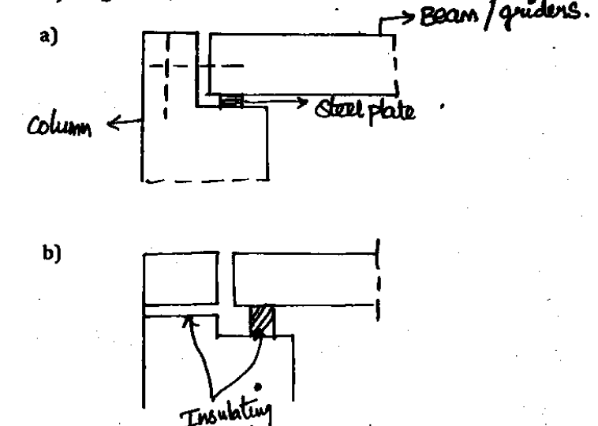
Hinge like joining of column to girders

Slide 48
b)Joining of column to beam at an intermediate junction:
In this method, a hinge like joint consist of either placing beam on the top of cantilever projecting or putting it on to the bottom of the adequately shaped open left out on the column shaft.
The beam temporarily rest on tongue like extension on a steel plate placed in the openings of the supporting surface.
The tongue is also provided with a steel plate anchored in to the concrete.
The other part of tongue is supported till the placing has been completed with the concrete cast through an opening left for this purpose.

Slide 49
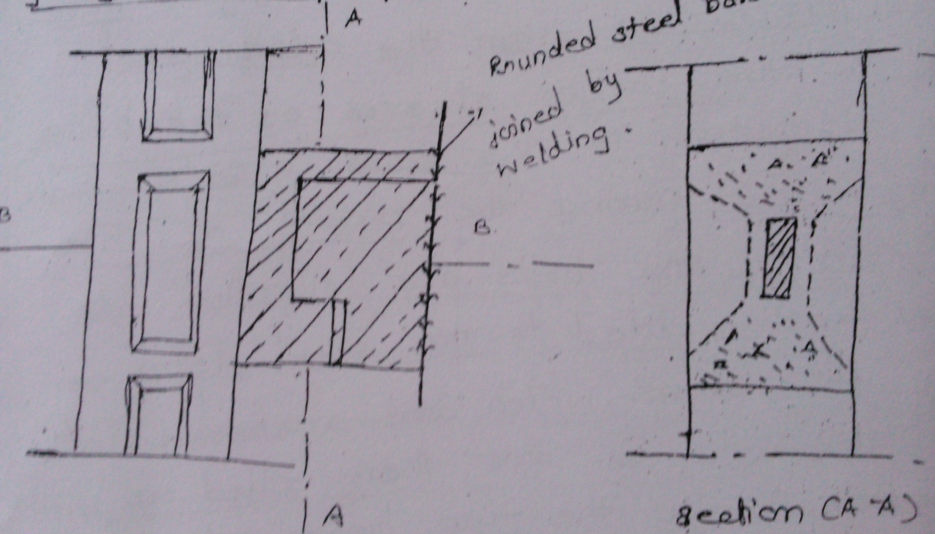

Slide 50
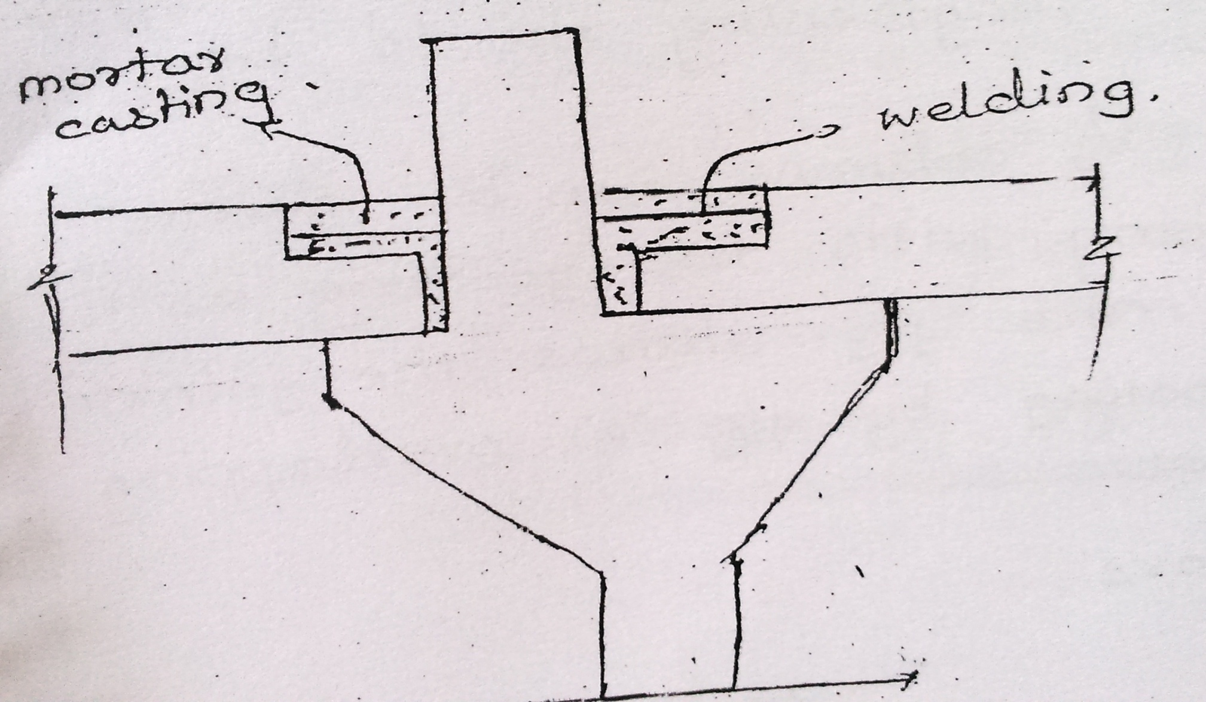

Slide 51
The fig shows a rigid joint.
The tongue shaped end of the beam rest temporarily on a cantilever projection from the column.
To resist the moment due to end fixity, steel dowels projecting from the column is welded to the reinforcement bars projecting from the beam.
Overlapping of steel bars can also be done instead of welding.
Then the stirrups are assembled on the joint and concreted.
The tongue like end of beam and cantilever projection from column are dimensioned in such a way to bear dead load of the beam.

Slide 52
The additional weight can be put on the beam after hardening of the insitu-concrete at the joint.

Slide 53
DIMENSIONING AND DETAILING
Dimensioning of joints:
a)According to Hungarian Standards (MNOSZ 15022:1952)
Lengthening
- Either by welding steel bars together (or) by overlapping hooked steel bars.
Lengthening of steel bars by overlapping is not permitted when the concrete is subjected to tension everywhere in RC structures.
The most suitable welded joint is arc welded joint, consisting of four welds and two laps.

Slide 54
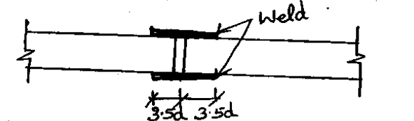

Slide 55
- Length of lap = 2*3.5d = 7d
- Diameter= 0.7d
d= diameter of steel bar lengthened
Grade of steel used
- Steel grades of 34.21B, 50, 35 Bmk are used in which the carbon content is almost 0.27%.
b)According to German standards
Cube strength of cement mortar should be at least 120 KP/cm² .
Joints in floor must be filled with cement mortar for ensuring adequate sound insulation.

Slide 56
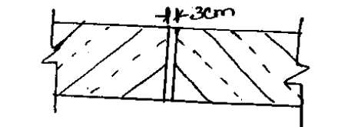

Slide 57
Width of the joint at the top must be at least 3cm where compressive force is to be transmitted.
Gaps between slab like beams are formed like grooves which are filled with cement mortar which is appropriate for transmission of shear.
The best concrete quality to be considered in case of an in-situ concrete are
- C300 if smallest dimension is not less than 10cm
- C225 if the smallest dimension is 3cm.
The permissible compressive stress is 50KP/cm² in case of joint less than 1cm wide.

Slide 58
c)According to Soviet code
The quality of concrete used for concreting of joints shall be better by 1o than that of joint members, provided the plan does not comprise any special stipulation.
If the joints between precast members are of small size and non reinforced, the c/s of the joints cannot subjected to either compressive or shear force.
If the joints are of larger size and reinforced, their c/s can be taken in to account because wider joints make easier and better concreting possible.

Slide 59
d)According to Austrian Code:
It is similar to Hungarian code
Specifies the values of the permissible shear stress in the precast and in-situ concrete.
Safety of joints against failure should not less than 3 fold.

Slide 60
Detailing:
It is as important as design since proper detailing of the engineering designs is an essential link in the planning and engineering process.
Many devastating collapses have occurred in history because of defective connections or detailing .
Detailing is very important not only for the proper execution of structures but also for the safety of the structures.

Slide 61
Important points in detailing are
- Prepare drawings properly and accurately and if possible label each bar and show its shape for clarity.
- Prepare bar-bending schedule (if necessary).
- Indicate proper cover – clear cover, nominal cover and effective cover to reinforcement.
- Decide detailed location of opening/hole and supply adequate details for reinforcements around the openings.
- Use commonly available sizes of bars and spirals.
- Grade of steel shall be clearly stated in the drawing.

Slide 62
- Deformed bars need not have hooks at their ends.
- Show enlarged details at corners, intersections of walls, beams and column joints and at similar joints
- Congestion of bars should be avoided at points where members intersect and make certain that all reinforcements can be properly placed.
- Make sure that hooked and bent up bars can be placed and have adequate concrete protection.
- Indicate all expansion, construction and contraction joints on plans and provide details for such joints.
- Location of construction joints shall be at points of minimum shear approximately at mid or near the mid points

Slide 63
Detailing (beams and slabs)
When splices are provided in bars, they shall be as far as possible , away from the sections of maximum stresses and shall be staggered.
When depth of beams exceeds 750mm in beams without torsion and 450mm with torsion , provide face reinforcement as per IS456:2000
Deflection in slabs/beams may be reduced by providing compression reinforcement.
Only closed stirrups shall be used for transverse reinforcement.

Slide 64
To accommodate bottom bars, it is good practice to make secondary beams shallower than main beams at least by 50mm.
Detailing (Columns)
A reinforced column shall have at least 6 bars of longitudinal reinforcement in circular sections.
Minimum 4 bars one at each corner of column in case of rectangular sections.
Keep outer dimension of column constant as far as possible for reuse of forms.
Preferable avoid use of 2 grades of vertical bars in same element.

Slide 65
JOINT MATERIALS
Flexible boards
Dowels
Sealants
Flexible boards:
A fibrous, compressible, flexible board such as ‘Flexcell’ is used.
It is cheap and readily available from builders merchants in pre-cut strips for required depths especially for creating expansion joints.
It is typically 12mm, 20mm or 25mm thick and right thickness should be chosen for joint.

Slide 66
No joint should be wider than 30mm.
Dowels:
400-600mm long, 20-32mm diameter and manufactured from Grade 250 steel.
Sealants
Three different types of sealants are available
a)Hot poured
Bituminous in origin.
Not widely used now a days.

Slide 67
b)Cold applied:
- Often a two-part polysulphide mix incorporating resins and curing agent is used.
Applied using a metallic gun and smoothed with a putty knife
Most commonly used joint
- It is performed elastomeric and need to squeezed and inserted in to clean and well-lubricated perfectly formed joint.

Slide 68
Types of joints:
i)Expansion joints
ii)Contraction joints
iii)Crack control joints
iv)Construction joints
Expansion joints:
Provided to allow the expansion and contraction of a concrete slab without generating potentially damaging forces within the slab itself or the surrounding structures

Slide 69
Expansion joints are usually a complete gap between adjacent bays i.e there is a definite break in the concrete and any reinforcing steel that may be present.
The adjacent bays are tied together by dowel bars, these dowels are sleeved in one of the bays to allow expansion to take place without generating stresses within the slab.
Contraction joints:
Also know as “shrinkage joints”.
This joints are provided only for contraction or shrinkage of the slab, as can be anticipated during the curing process.

Slide 70
Crack Control Joints:
Crack control joints are a partially-formed contraction joint that aims to ensure that when concrete does crack, it cracks in a predictable manner at a precise location.
Construction Joints:
It is commonly formed joint in concrete construction.
Construction joints can be horizontal or vertical and are formed when placement of concrete is interrupted for some reasons.

Slide 71
ELIMINATION OF STRESSES DURING ERECTION:
Surplus stresses are formed when members are hoisted and placed.
These stresses are called handling or erection stresses.
A good method of construction is characterized by elimination of these stresses.
It should be eliminated in such a way that no additional reinforcement is required.
The stresses due to wind or other external forces are avoided by a temporary bracing of placed members .

Slide 72
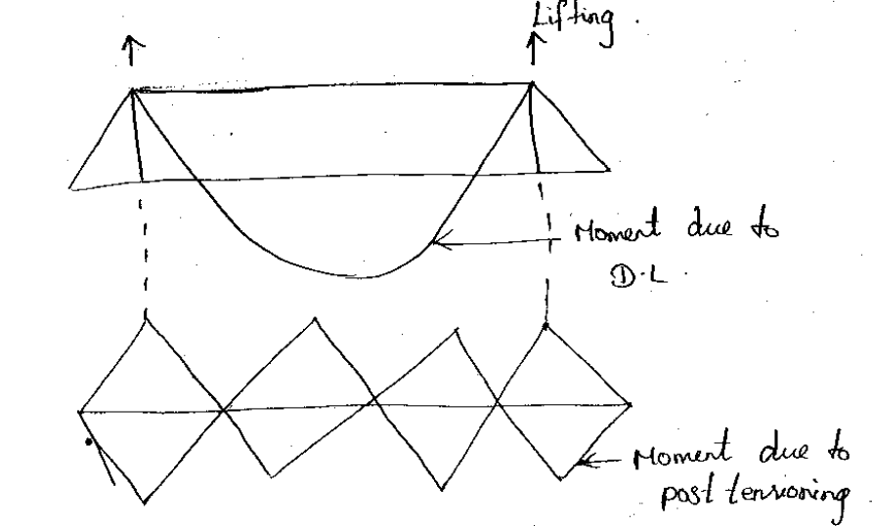

Slide 73
Hoisting of a straight beam is accomplished by lifting it at 2 points.
Location of these 2 points depends on the reinforcement if the beam is simply supported one, the lifting point should be at the ends or in such a manner that the arising moments should be equalised.
When hoisting a continuous beam, post tensioning is necessary.

Slide 74
GIRDERS:
A girder having a length of 25m is clutched at two points when it is hoisted but to avoid the tilting of same girder requires at least 4 lifting points.
These points should be determined based on equal moments simultaneously taking in to consideration, the reinforcement design to resist the force affecting the beam in its final position.

Slide 75
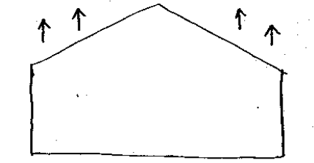

Slide 76
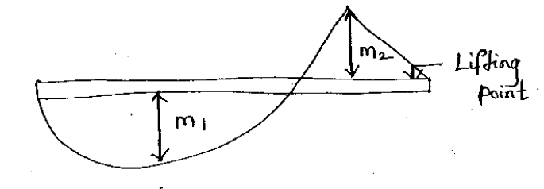

Slide 77
COLUMN:
The most advantage point for lifting should be first determined.
The column during hoisting acts like simple supported beam with cantilever at the end loaded by dead weight, temporary post tensioning must be worked out so that additional reinforcement is not required.
Elimination methods:
The stresses developing in members during hoisting and placing differs.
An additional reinforcement may be required sometimes but becomes unnecessary after placing is finished.

Slide 78
Hence additional stresses as well as reinforcement required to resist them should be eliminated.

Slide 79
Stress elimination methods in precast members:
i)By using an I profile steel beam to the girder
ii)By post tensioning
iii)Bracing of two stanchions
iv)Multi point pick up

Slide 80
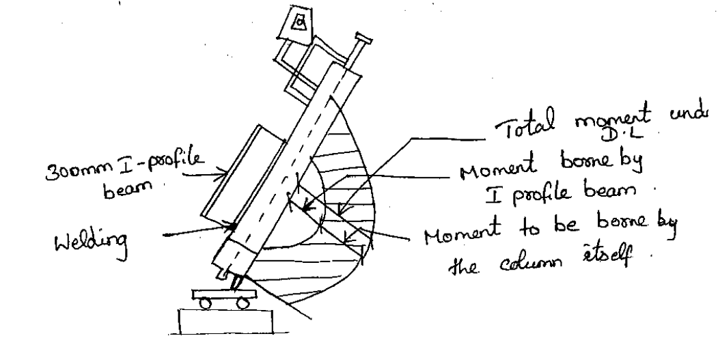

Slide 81
