Slide 1

PREFABRICATED STRUCTURES
UNIT V
DESIGN FOR ABNORMAL LOADS

Slide 2
COLLAPSE:
Collapse is the failure of structure after attaining its life span or time.
Due to faulty design & detailing, poor construction materials, poor construction practices may also lead to failure of the structure before attaining the life span.
The failure occur in any form such as failure due to shear, flexure, cracking, deflection and torsion.
Due to any of these failure if the structure completely damages without any possibility of reusing, it is called collapse of the structure.

Slide 3
Collapse indicates the complete failure of the structure.
IS 456:2000 specifies conditions for limit state of collapse.
The code conditions for various limit states, stress strain graphs & assumptions are discussed in the code.

Slide 4
PROGRESSIVE COLLAPSE:
Progressive collapse is a structural failure which is initiated or started by localised structural damage and subsequently develops as a chain reaction into a failure that involves a major portion of the structural system.
If in the structure, the cracks are developed at some places which results in corrosion in concrete, shear failure in beams, deflection in structural elements such as beams and lintels, sunshades, roof slab etc., and column gets buckle.
These failures are the indicators of the collapse of the structure.

Slide 5
These failures start gradually, develops and finally leads to the entire failure of the structure.
This sort of collapse by indication of any one failure pattern is called progressive collapse.
If the progressive collapse is noticed, the immediate steps to be taken is to prevent the structure by doing some repair, rehabilitation or retrofitting methods.
These preventive methods will protect the structure for some time and total failure is delayed for some time.

Slide 6
EXAMPLES OF PROGRESSIVE COLLAPSE
RONAN POINT:
In May 1968, a gas explosion occurred in the newly occupied 24-storey Ronan point apartment building located in London, England.
The explosion took place in an apartment kitchen near one corner of the building at 18th floor.
The blast blew out a primary supporting exterior bearing panel which led to loss of support for floors above.
This in turn began a chain reaction of collapse upwards to the roof level.

Slide 7
As a result of the load generated by falling debris lower floor also collapsed.
Construction of Ronan point complex primarily consisted of precast panels.
The building lacked the connection details necessary to effectively redistribute the load and reinforcement continuity between panels.
There is no mechanism for achieving alternative load paths once failure began to propogate.

Slide 8
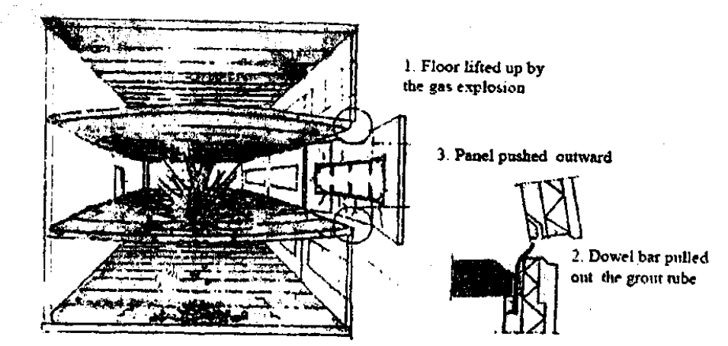

Slide 9
A.P Murrah Federal Building:
In morning of April 19, 1995, a terrorist bombing took place at 9 storey A.P Murrah Federal building in Oklahoma city.
This attack resulted in many significant loss of lives and inflicted many injuries to the occupants of the building.
When the bomb detonated, primary support columns along the perimeter were locally damaged.
The localized damage of these bearing members initiated a series of failures that extended much of north face and through the width of the building in eastern part of structure.

Slide 10
The loss of column along the ground level created an 80ft unsupported length.
This was a primary mechanism that caused the progressive collapse of the building.
This type of a structural feature is typically avoided .
Use of transfer girder would have potentially limit the building ability to effectively redistribute load.

Slide 11
WORLD TRADE CENTRE 1 AND 2:
Each of the twin towers of world trade centre 1 & 2 collapsed on 11th September 2011.
A Boeing jetliner 767 crashed in to tower at high speed.
The crash caused structural damage at and near the point of impact zone lost its ability to support the load above it.
Due to impact damage and fire damage, the structure above collapsed and weight and impact of collapsing upper part of tower caused a progression of failures extending downward all the way to ground.

Slide 12
ABNORMAL LOADS:
Abnormal loads are the loads other than conventional design loads (dead, live, wind etc.,) for structures such as air blast pressure generated by explosion or impact by vehicles etc.,
Causes:
i)Accidental impact
ii)Faulty construction
iii)Foundation failure
iv)Violent changes in air pressure

Slide 13
Importance of avoidance of progressive collapse:
Provides a solid exterior surface to meet blast resiliency requirements.
Delivers the inherent strength of concrete tilt-up panels for overall durability.
Minimizes cost to fix a damaged area compared to a steel framed building.

Slide 14
CODAL PROVISIONS
IS 13920-1993
The principle design consideration to followed is to ensure sufficient ductility as per Indian standard code IS:13920.
It ensures adequate ductility without loss of strength for structural members such as beams, columns and walls and to prevent sudden or non-ductile type of failure.
The important design considerations are
- Use of low percentage of tensile reinforcement of relatively low grade and use of compression reinforcement.

Slide 15
- Use of confined concrete in compression zone by using closely spaced hooks or spirals to avoid compression failure associated with over reinforcement section.
- Reinforcement detailing with regard to anchorage, splicing and quantity of minimum reinforcement in the section.
- Continuity in construction to improve the inelastic behaviour of the structure with moment re-distribution and energy dissipation at several plastic hinges.

Slide 16
Structural stability and stiffness are important factors to be considered in codal provisions to take care of abnormal loads and progressive collapse.
The structural system should be designed such that the plastic hinges are formed at suitable locations resulting in failure of individual structural members only.
The use of redundant structure such as continuous rigid frames will ensure development of alternative load paths, to help the re-distribution of forces and dissipation of energy to prevent the progressive collapse of the structure.

Slide 17
In order to ensure the ductile behaviour with minimum damage, the foundation should not yield (sink) prior to the failure of super structure.
Hence the moments, shear and axial forces are transferred from super-structure to the foundation system under the condition of actual yielding should be resisted by foundation with the margin of safety of 1.5 applied to the loads & 1.15 applied to materials.
This ensures foundation is relatively stronger when compared to super structure.

Slide 18
Other codes that discuss about progressive collapse are
i)ASCE 7 - 02
ii)ACI 318 – 02
iii)GSA PBS facilities standards 2000
iv)GSA PBS facilities standards 2003
v)GSA PBS progressive collapse guidelines 2003.

Slide 19
ASCE 7 -02
American society of Civil Engineers, “Minimum design loads for building and other structures” (2002)
Explains about general structural integerity
Building and other structures shall be designed to sustain local damage in the structural system but not as a whole, while other parts remain stable and not being damaged to an extent disproportionate to the original damage.

Slide 20
This shall be achieved through an arrangement of structural elements that provides stability to the entire system by transferring loads from any locally damaged region to adjacent regions capable of resisting those loads without collapse.
This shall be achieved by providing sufficient continuity , redundancy or energy-dissipating capacity.
The focus in the ASCE standard is on redundancy and alternate load paths over all other means of avoiding disproportionate collapse.
But the degree of redundancy is not specified and the requirements are threat-independent.

Slide 21
ACI318- 02
American Concrete Institution , “Requirements for structural concrete” (ACI 2002) explains about requirement for structural integrity.
There is no explicit explanation of redundancy or alternate load paths in the code.
In the detailing of reinforcement and connections, members of structure shall be effectively tied together to improve integerity of overall structure and many specific requirements for continuity of reinforcing steel and interconnection of components are explained in the code.

Slide 22
GSA PBS (2000)
The structure must be able to sustain local damage without destabilizing the whole structure.
The failure of beam, slab or column shall not result in failure of structural system below, above or in adjacent bays.
Collapse of roofs and floors must not be permitted.
GSA PBS (2003)
Made alteration to previous code.
The structural provisions apply only to buildings deemed to be at the risk of blast attack.

Slide 23
For such buildings, the chapter provides general performance guidelines and references to various technical manuals for the study of blast effects.
GSA PBS Progressive Collapse Guidelines (2003)
Buildings and major modernization projects begins with a process for determining whether a building is exempt from progressive collapse considerations.
Exemption is based on type and size of the structure (any building over 10 stories is non exempt) and is unrelated to level of threat.

Slide 24
Typical non-exempt buildings in steel or concrete have to be shown by analysis to be able to tolerate removal of one column or one 30ft length of load bearing wall without any collapse.

Slide 25
METHODS OF PREVENTING DISPROPORTIONATE COLLAPSE:
a)Redundancy or alternate load paths
b)Local resistance
c)Interconnection or continuity

Slide 26
STRUCTURAL INTEGRITY:
It is an ability to hold together under a load , including its own weight resisting breakage or bending.

Slide 27
GUIDELINES FOR ACHIEVING STRUCTURAL INTEGRITY:
i)Connection between structural members should be ductile.
ii)Good plan layout
iii)An integrated system
iv)Return on walls
v)Interior explosion
vi)Changing direction of span of floor slab

Slide 28
Equivalent Design Load for considering abnormal effects such as EQ, cyclones, floods etc.,:
Loads are calculated in any design and structure is designed to withstand the load.
Load for which the structure is actually designed is called designed load.
In ordinary design, the abnormal effects such as EQ, cyclones etc., are not taken in to account.
If in a particular area, these abnormal effects are expected to occur or take place means the design of these structures cannot be done considering design load alone.

Slide 29
An equivalent or equal weightage is given to take care of abnormal effects such as EQ, cyclones etc., is called equivalent design load.

